Slide 1
Working together
to help people feel
safe and well

Slide 2
Why the fire & rescue service?
Strong and trusted brand
Eyes and ears
Same target groups (elderly and vulnerable)
Capacity and opportunities to do more
Experienced in prevention
Capacity and skills available
Notes:
Elderly people are one of our key target audiences for fire safety. People over 80 are 4 times more likely to be killed or seriously injured in a fire.
We are going to fewer fires and we can redeploy some of these resources into other areas, as they need to remain available to respond to emergencies. We have increased the size of our specialist team as we want to reach more people. This gives us capacity to take more referrals and offer more interventions to help people stay safe & Well.

Slide 3
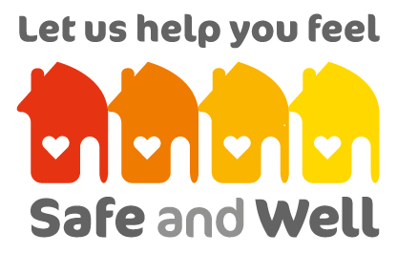
Safe & Well Home Visits
Co-designed with NHS and PH
Zero cost to NHS
Opportunist in nature – efficiency saving
Include actions to reduce risk
Improve quality of life outcomes
Reduce demand on health services
Reduce health inequalities
Notes:
We want to continue developing these Safe & Well visits with the NHS and Public Health. We need to know the issues and the opportunities for the FRS to make a difference.
We will not charge the NHS for any of our services. But we cannot recruit or dedicate resources specifically for health, we want to take opportunities to ‘bolt-on’ services where it makes sense because we are there already.
We want to help improve quality of life outcomes, helping people to live independently and therefore reduce demand on health and social care services.

Slide 4
Safe & Well home visits
Over 30,000 visits per annum;
Around 45 minute visit to assess environmental and behavioural risks;
Free to customer – fully funded by FRS;
Advice and physical measures to reduce risks in the home;
Not just fire safety.

Slide 5
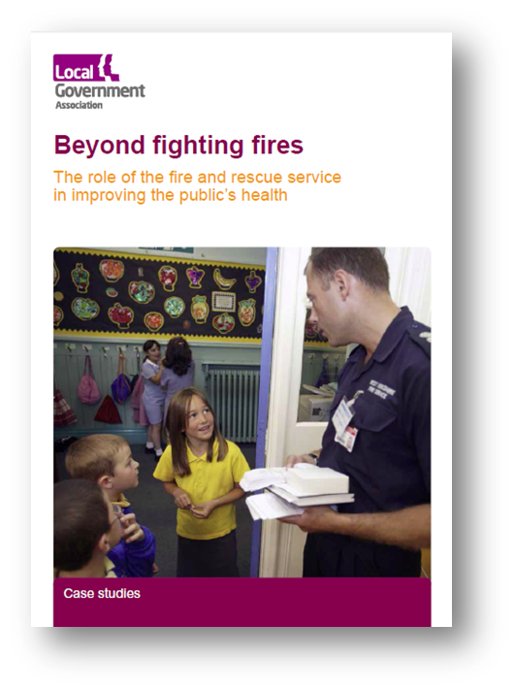
Our priorities
Elderly and frail;
People with poor mobility;
Other physical disabilities;
Dementia and Mental Health;
Learning disabilities;
People who smoke in the home;
Specialised housing;
Deprivation and poor housing.
Notes:
Kent Fire & Rescue Service is currently focusing on these areas:
Dementia – aiming to ensure all of our staff are well trained to support people living with dementia. Developing a new dementia strategy.
Prevention and health promotion – including SMOKING cessation also proposing to include Children Burns and Scalds
Falls prevention
Excess winter deaths and indoor overheating

Slide 7
Why focus on the elderly?
People over 80 are four times more likely to be killed or seriously injured in a fire;
21 of the 30 fatalities since 2010 have been over 70;
Ageing population;
Excess winter deaths (cold homes and flu);
About a third of all people aged over 65 fall each year.
Notes:
Age is probably the biggest factor which increases risk.
It’s an issue for fire safety, but also the same issues for all of our partner agencies.
Older people account for the majority of fatalities due to accidental fires in the homes. They are not necessarily more likely to have a fire, but the consequences are far more serious.
They account for a lower proportion of serious injuries, as these are often people who try and put the fire out themselves – but could have self rescued.
Although fire is our core business – we recognise that the risk posed by falling or cold weather are actually far higher!

Slide 8
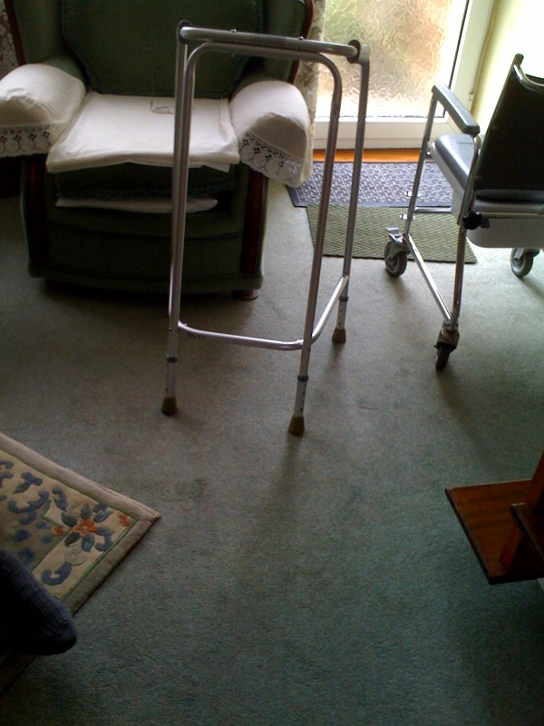
Environmental factors
Clutter;
Loose rugs / carpets / cables;
Poor lighting;
Electrics;
Grease build-up;
Appliances;
Heating.
Implicated in up-to 50% of all falls
Voermans NC et al. Pract Neur 2007; 7: 158-71

Slide 9
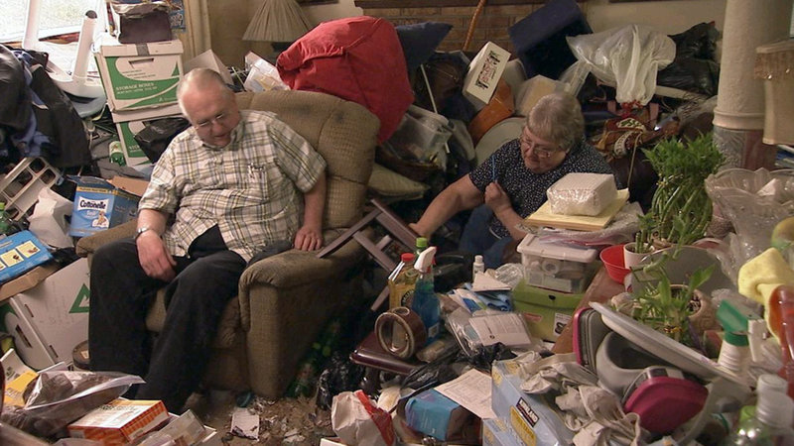
Hoarding

Slide 10
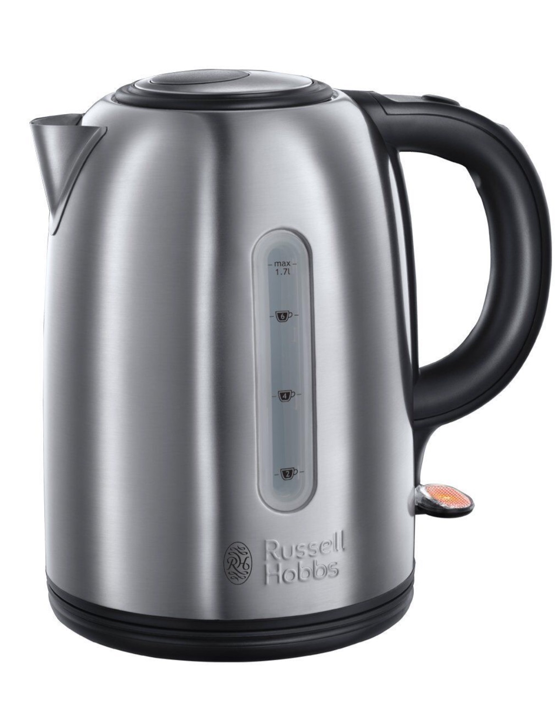
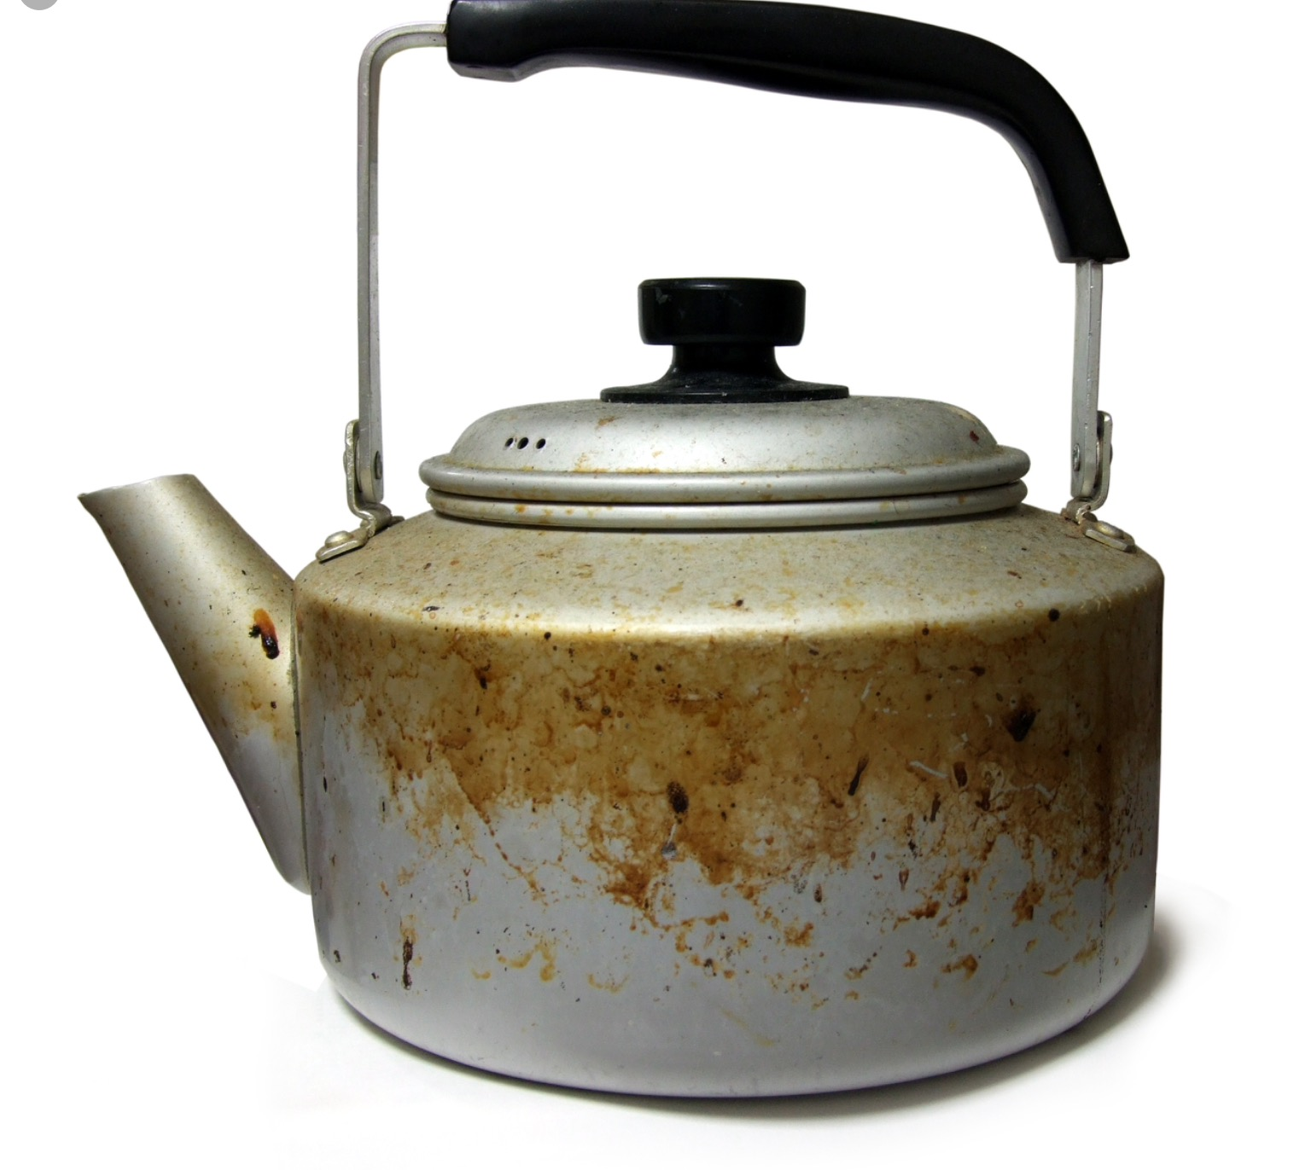
Dementia

Slide 11
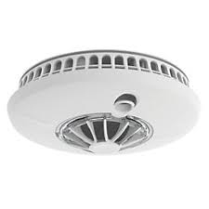
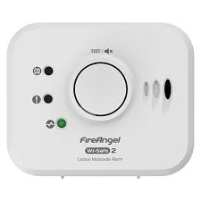
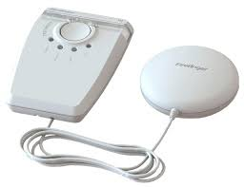
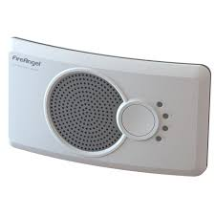
Technology

Slide 12
StoveGuard

Slide 13
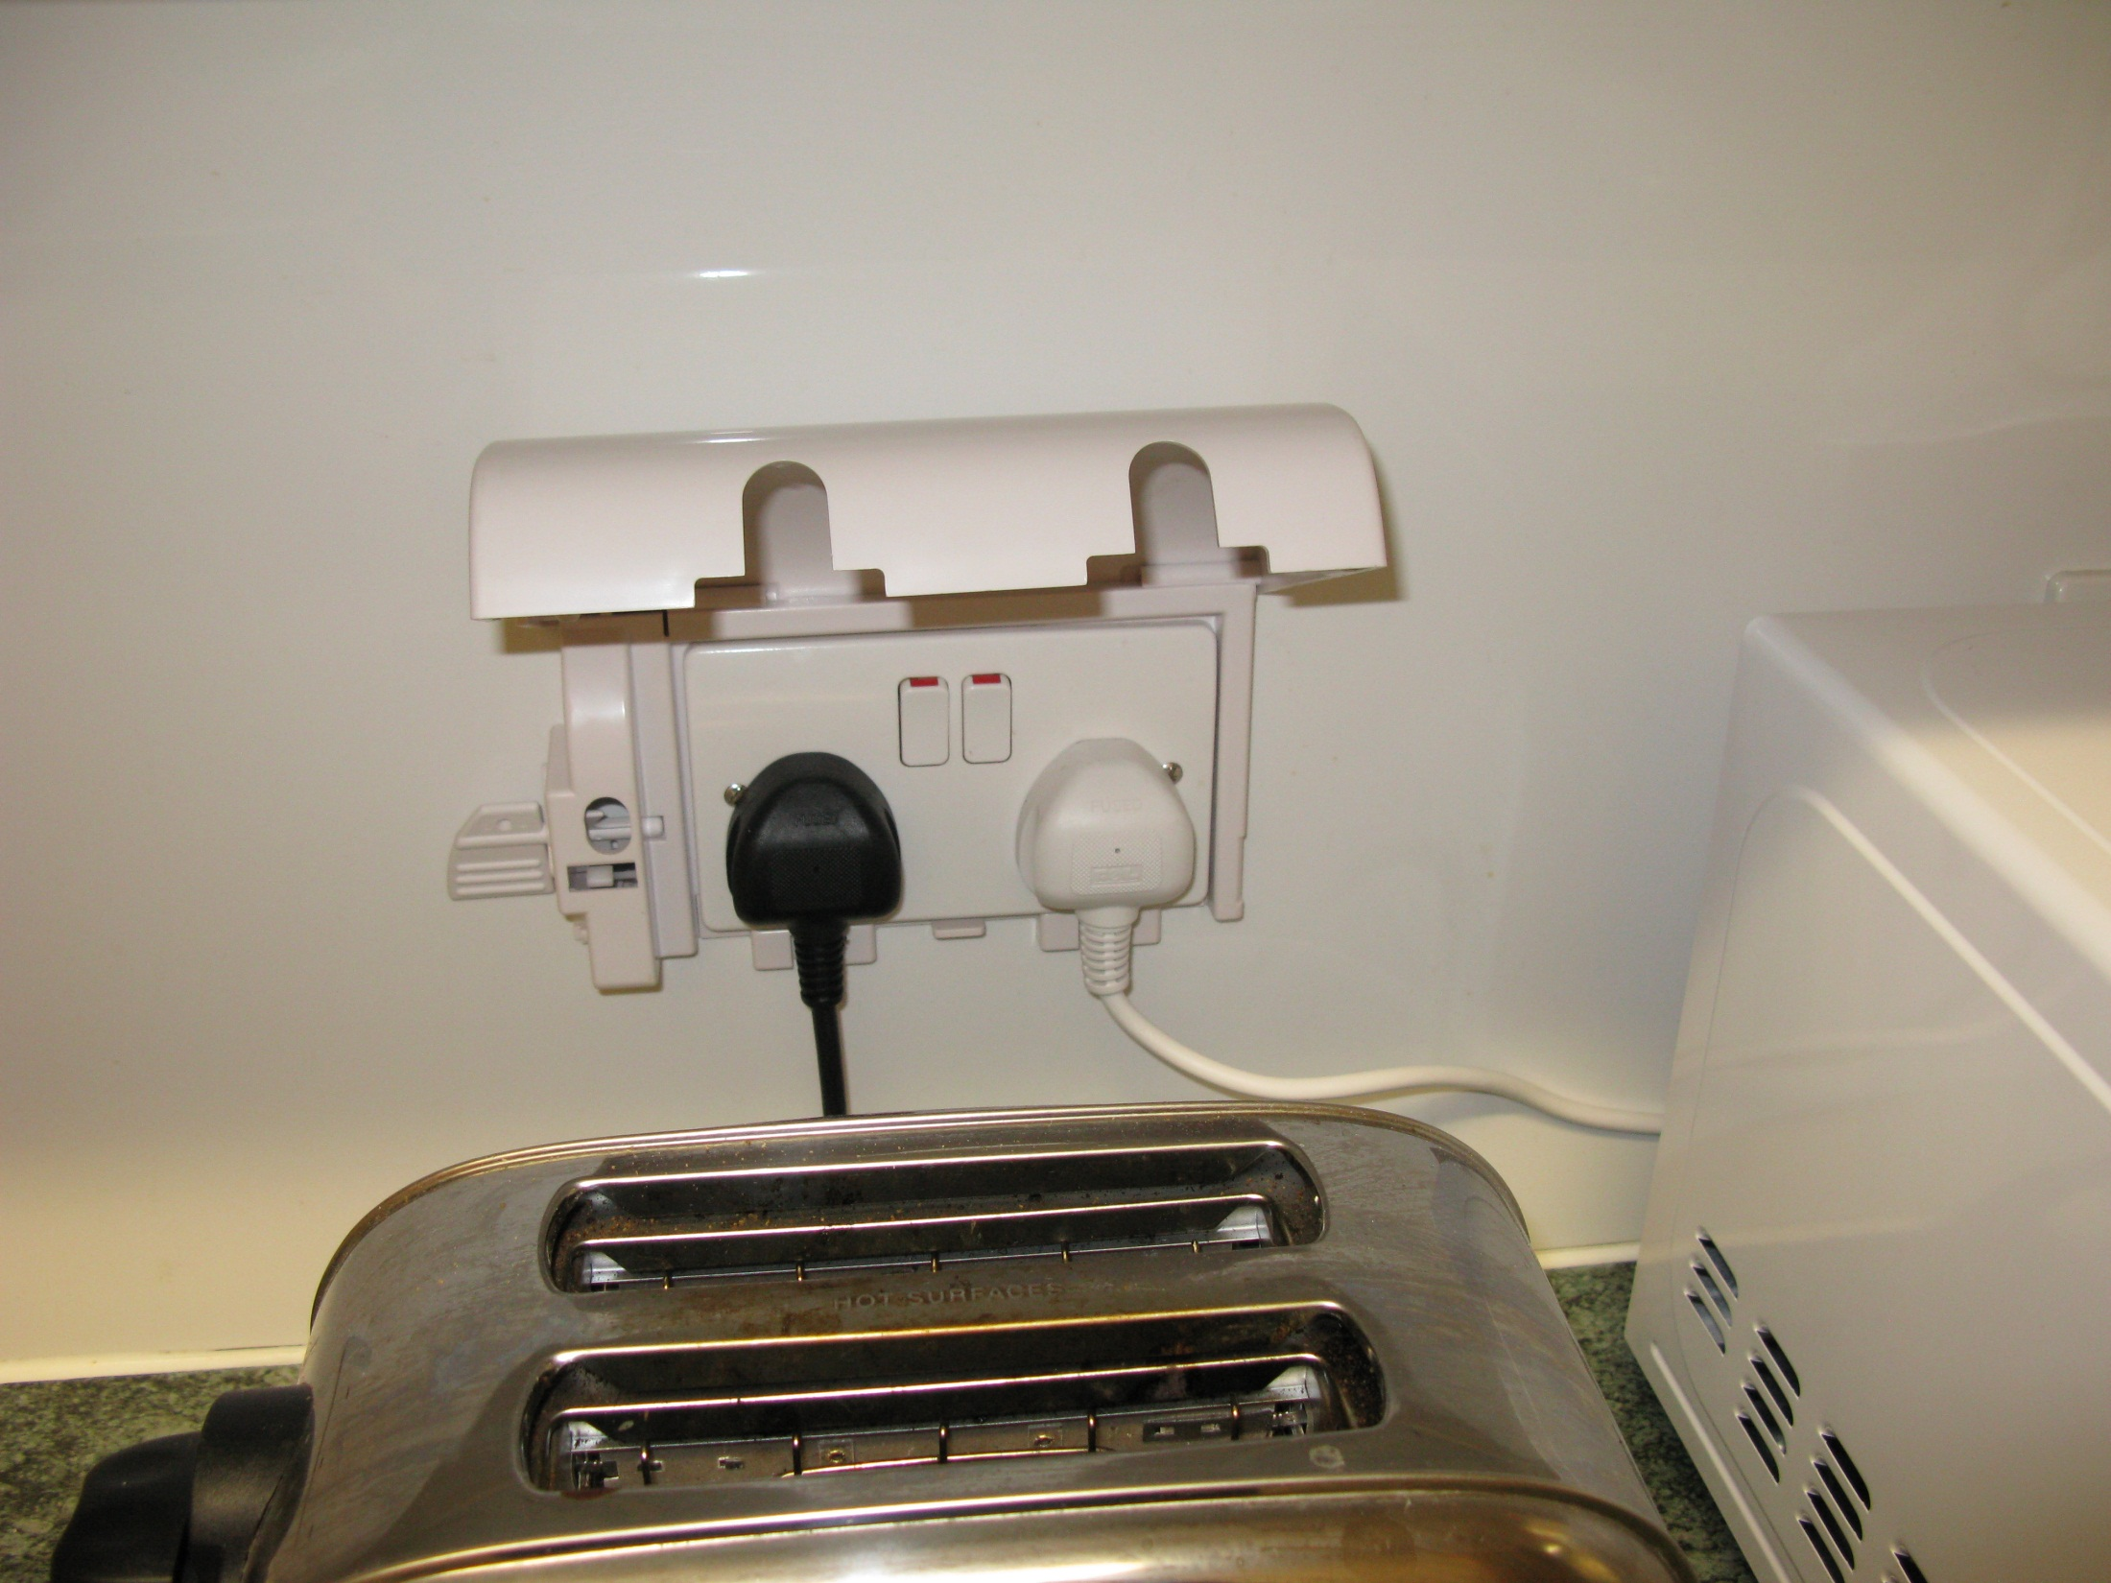

Slide 14
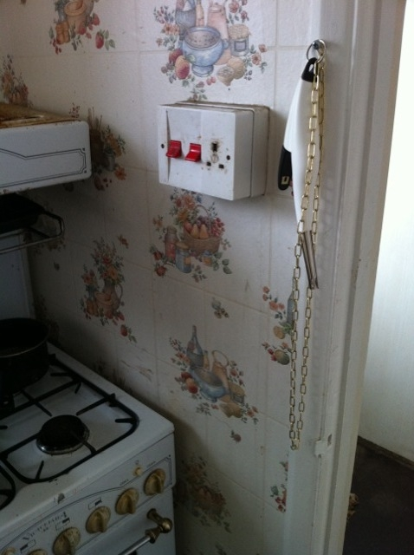
Risk reduction measures Bespoke solutions

Slide 15
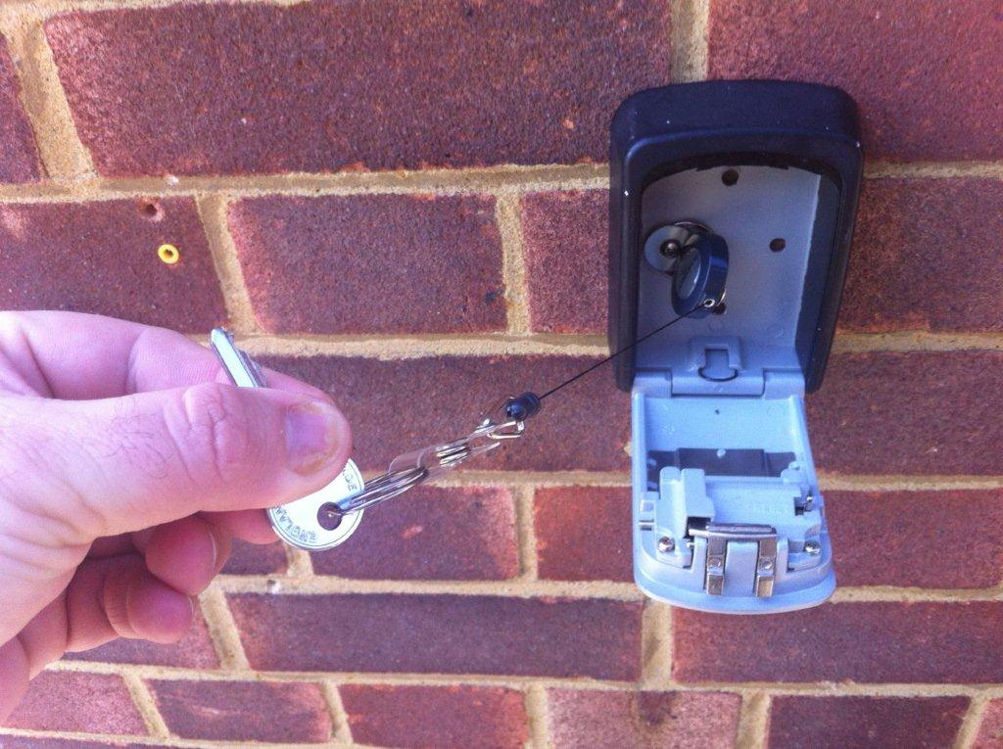

Slide 16
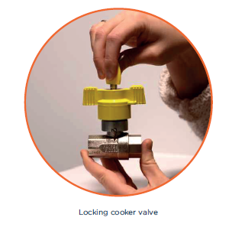
Locking Cooker Valve

Slide 17
Together we can…..
Keep people well and help them live independently in their own home for longer

Slide 18
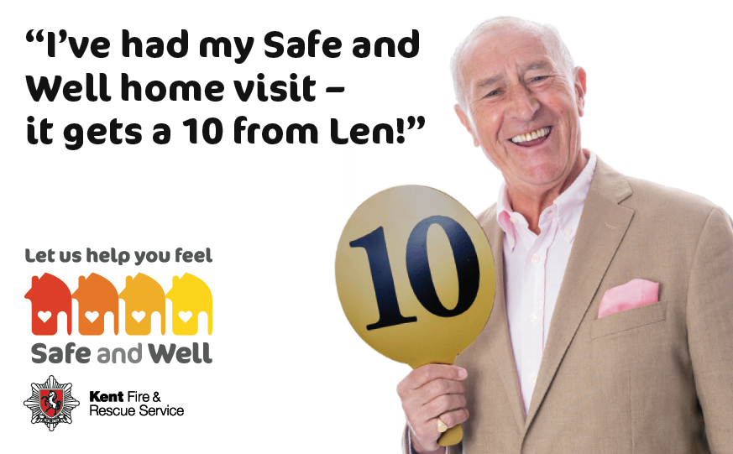

Slide 19
For more information
Email: home@kent.fire-uk.org
Telephone: 01622 692121
Safe and Well
For referrals or general advice - 0800 923 7000
Web Search ‘KFRS Safe and Well’
Notes:
We currently complete around 10,000 Safe and Well visits per year, but plan to double that number at least. Most are completed by a central team of 20 officers, but our operational crews will also be doing some lower risk visits.
Typically take 45mins to complete. Assess the environmental risks around the home as well as taking time to understand and influence people’s behaviours. With older people it is often about the environmental changes we can put in place as changing behaviour can be more difficult.
As well as (obviously) reducing fire risk we have also prioritised Dementia & Mental Health, preventing falls, reducing excess winter deaths/summer overheating and helping people to stop smoking.
We are introducing Making Every Contact Count, as part of a spearhead project.
We can take referrals from any agency which identifies a risk and we make referrals into a diverse range of partners.

