Slide 1
Regional Forum for Kent
and the South East
22 February 2018
Shelagh Grant
Chief Executive, The Housing Forum
Working with NHBC
Notes:
Cover with picture mainly white sent to the back
1 speaker from THF

Slide 2
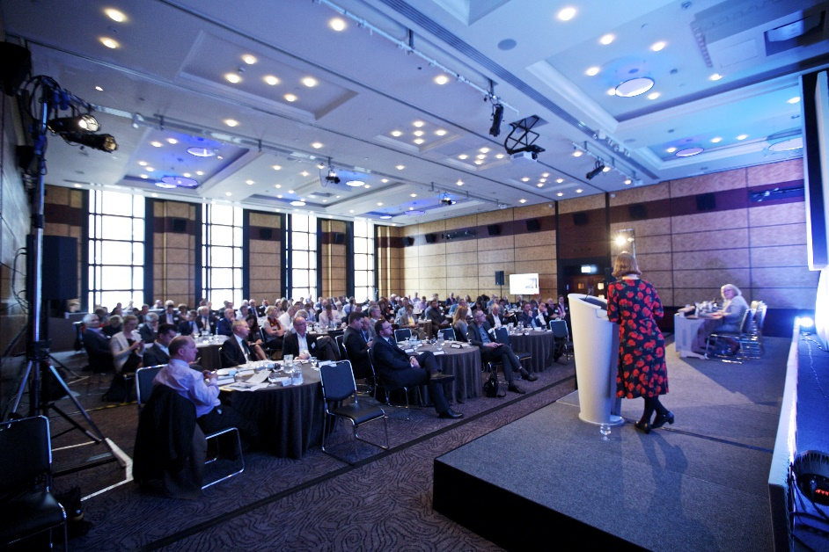
The all-industry membership network for housing and construction
set up following the 1998 Egan report “Rethinking Construction”
to encourage long term partnering arrangements between clients and providers to secure consistency, continuity and value for money
an average of one industry event a week
advised by a senior board representing all sectors with observers from HCA, DCLG, GLA, CIOB and RICS
Notes:
Dual images on left

Slide 3
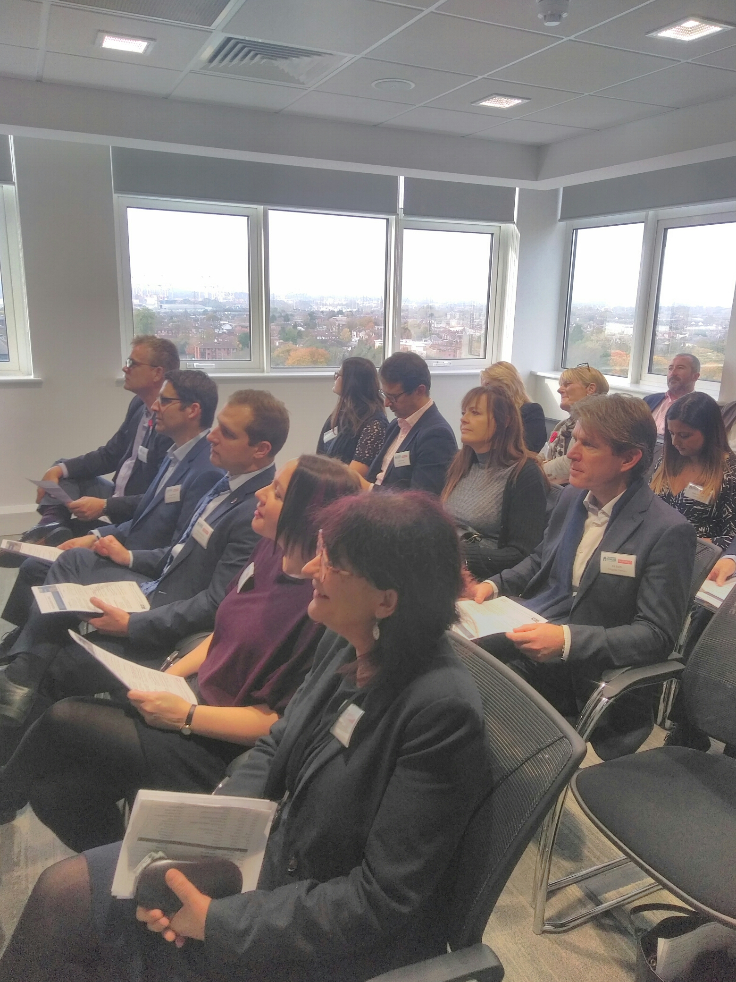
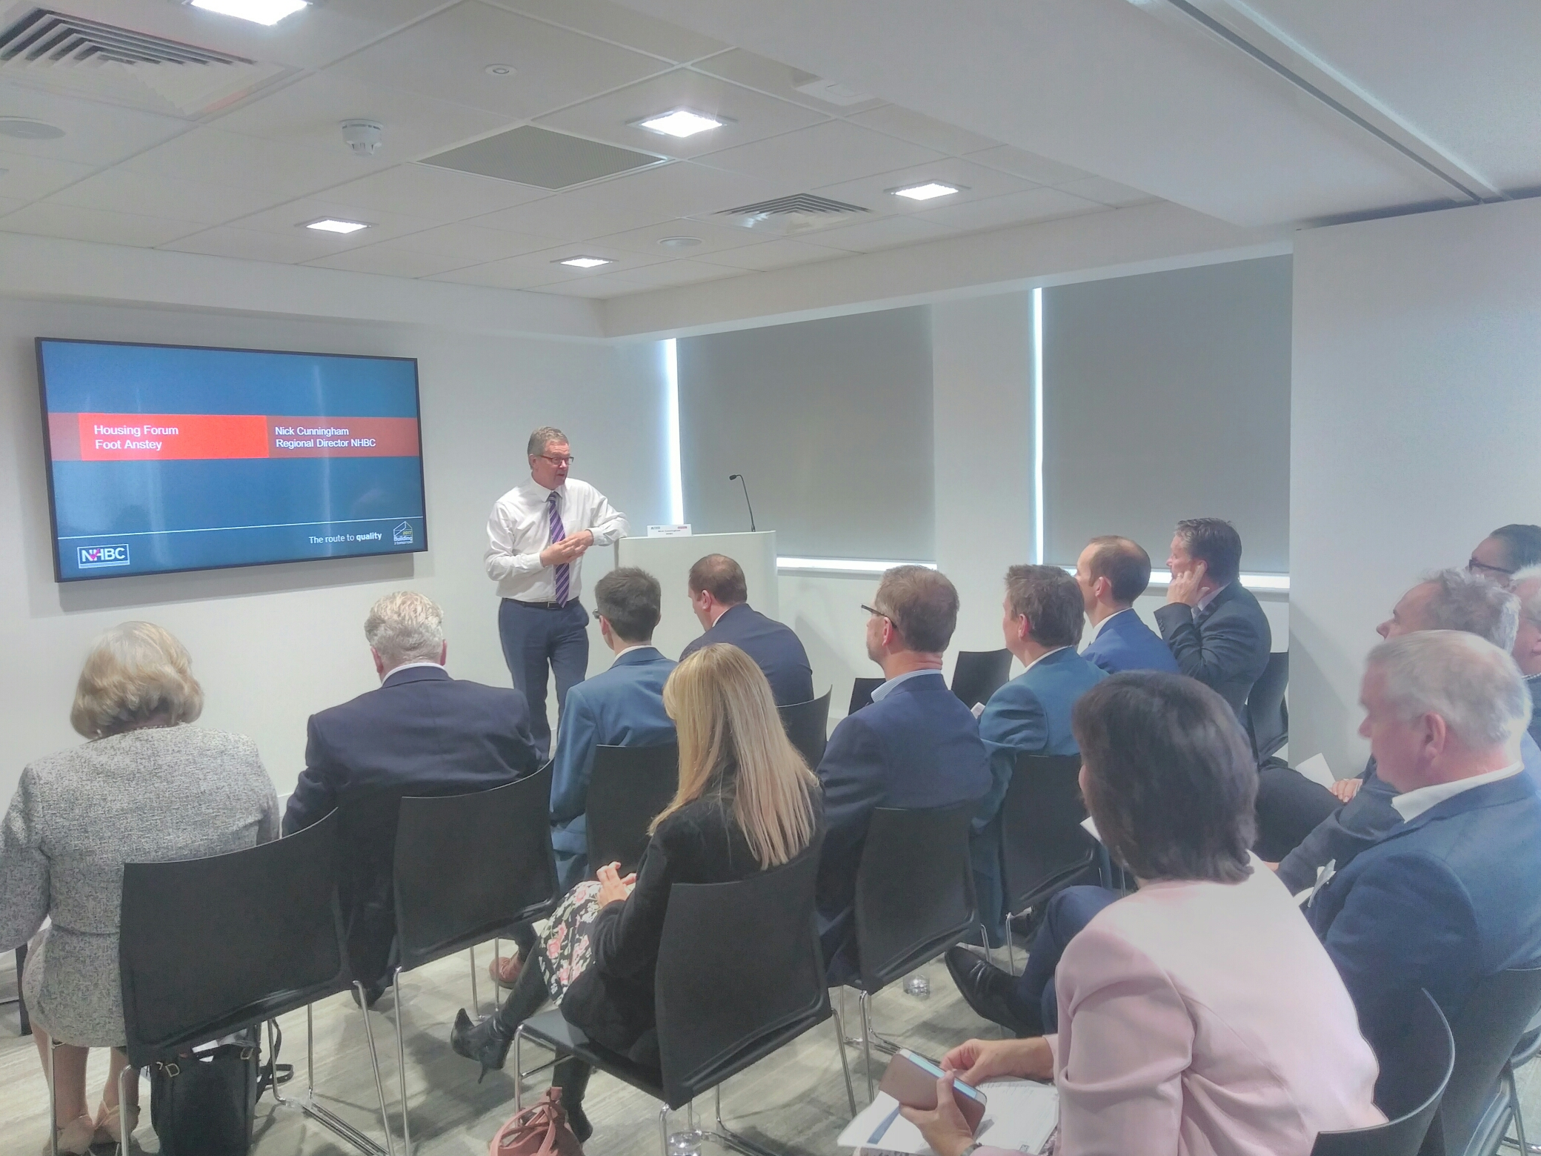
Regional Forums
Focus on the specific drivers of local housing markets
Bring together the range of partners working on housing and regeneration
Notes:
Dual images on left

Slide 4
The Membership Network
Housing Providers
Developers, Housebuilders & Contractors
Local Authorities
Board Members
Clarion Housing Group
Cross Keys Homes
East Thames Ltd
ELM Group
emh Group
Guinness Partnership
Hexagon Housing Association
The Hyde Group
Newlon Housing Trust
Octavia
PA Housing
Places for People Group
Rochdale Boroughwide Housing
Saxon Weald
Southern Housing Group
Sovereign Housing Association
Swan Housing Group
Thames Valley Housing Association
Town & Country Housing Group
Wandle Housing Association
Waterloo Housing Group
whg
Worthing Homes
Bugler Developments
Durkan
Galliford Try
Hill Group
Ian Williams
Keepmoat Regeneration part of the ENGIE Group
Kier Living
Kind & Company Builders
Mears New Homes
Osborne Homes
Rydon Group
Sanctuary Maintenance Contractors
TSG Building Services Limited
Wates Living Space, Wates Residential
Willmott Partnership Homes
Kent Housing Group
- Ashford Borough Council
- Canterbury City Council
- Dartford Borough Council
- Dover District Council
- Gravesham Borough Council
- Kent County Council
- Maidstone Borough Council
- Medway Council
- Sevenoaks District Council
- Shepway District Council
- Swale Borough Council
- Thanet District Council
- Tonbridge & Malling Borough Council
- Tunbridge Wells Borough Council
Greater Manchester Combined Authority
- Bolton Metropolitan Borough Council
- Bury Council
- Manchester City Council
- Oldham Council
- Rochdale Borough Council
- Salford City Council
- Stockport Metropolitan Borough Council
- Tameside Metropolitan Borough Council
- Trafford Council
- Wigan Council
Greater London Authority (GLA)
- London Borough of Barking & Dagenham
- London Borough of Barnet
- London Borough of Bexley
- London Borough of Brent
- London Borough of Bromley
- London Borough of Camden
- London Borough of Croydon
- London Borough of Ealing
- London Borough of Enfield
- London Borough of Hackney
- London Borough of Hammersmith & Fulham
- London Borough of Haringey
- London Borough of Harrow
- London Borough of Havering
- London Borough of Hillingdon
- London Borough of Hounslow
- London Borough of Islington
- London Borough of Lambeth
- London Borough of Lewisham
- London Borough of Merton
- London Borough of Newham
- London Borough of Redbridge
- London Borough of Richmond upon Thames
- London Borough of Southwark
- London Borough of Sutton
- London Borough of Tower Hamlets
- London Borough of Waltham Forest
- London Borough of Wandsworth
- Royal London Borough of Greenwich
- Royal London Borough of Kensington & Chelsea
- Royal London Borough of Kingston upon Thames
- City of London
- City of Westminster
Birmingham City Council
Hull City Council
Developers / House builders & Contractors
Caroline Compton-James | Osborne
Kate Ives | Wates Living Space - Homes
Stephen Teagle | Galliford Try PLC
Housing Providers
Bob Heapy | Town & Country Housing Group
Guy Burnett | Thames Valley Housing Association
Ben Denton | Sovereign
Suppliers / Manufacturers
Mike Fairey | Fusion Building Systems
Stuart Hough | Travis Perkins Managed Services
Chris Moyes | Polypipe Group Ltd
Specialists / Consultants
Mike De'Ath | HTA Design LLP
Richard Jones | Arcadis LLP
Andy von Bradsky | von Bradsky Enterprises
Co-optees
John East | London Borough of Barking & Dagenham
Chris Tinker | Crest Nicholson
Andy Tookey | Baily Garner
NHBC Board Representative
Mehban Chowdery | NHBC
Graham Sibley | NHBC
Observers
Paul Finch | CIOB - Sanctuary
Chris Crook | RICS
Paul McGivern | Homes & Communities Agency
Jamie Ratcliff | Greater London Authority
Specialist Consultants
Airey Miller
AMCM Group
Arcadis LLP
Arcus
Ark Housing Consultancy
Baily Garner
BLP Insurance
BM3 Architecture
bptw partnership
calfordseaden LLP
Capsticks
CGS Partnerships
Conisbee
Foot Anstey LLP
Hawkins\Brown Architects
HTA Design LLP
Hunters
Levitt Bernstein
Martin Arnold
MDA Consulting Ltd
NHBC
Pollard Thomas Edwards
PRP, Rund Partnership Ltd
Silver, Stride Treglown,
Trowers and Hamlins LLP,
Waind Gohil + Potter Architects, Waterstons
Suppliers, Manufacturers & Service Providers
Aggregate Industries
British Gypsum Forticrete
Fusion Building Systems
Luceco
ORCA LGS Solutions
Polypipe Group
SE Controls
Structural Timber Association
Switch2 Energy Limited
Travis Perkins Managed Services
Worcester Bosch
Investors
Legal & General Property
Associate Members
South East Midlands Local Enterprise Partnership (SEMLEP)

Slide 5
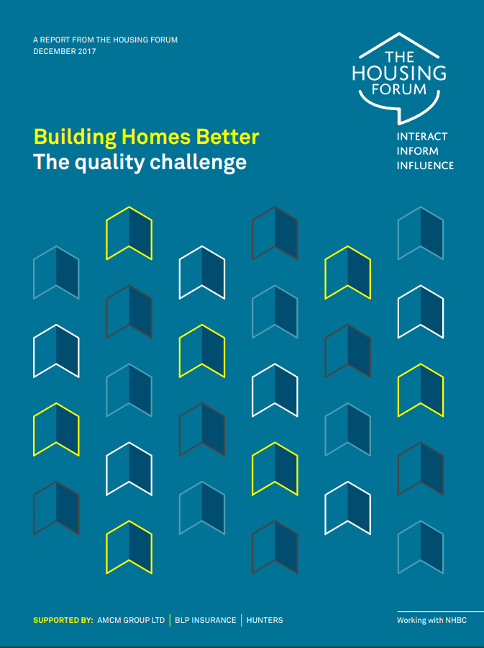
Our latest reports
Reports are available at: housingforum.org.uk/publications/housing-forum-reports-
Notes:
Dual images on left

Slide 6
With thanks to Kent Housing Group
for hosting this Forum
Notes:
Layout example using 3 column layout

