Slide 1
Preparing for Universal Credit
Mark Walker – Head of Income (Optivo)

Slide 2
1
Welfare Reform
About us..
Optivo –
44,000 properties
Formerly AmicusHorizon and Viridian
Merged May 2017
Across London/South East plus The Midlands
1500 new homes each year

Slide 3
1
Welfare Reform
Our Journey
Early 2012 –
Centralised - 1 team
Created Financial Inclusion Team
Launched Financial Inclusion Strategy
Improved service offer: 8 - 8 weekdays, 9-1 Saturday
Tenant led project group

Slide 4
2
Welfare Reform
Our Journey
Outcome –
Greater flexibility and ability to respond to changing landscape of arrears
Reviewed in 2015 as a result of July 2015 Budget

Slide 5
3
Welfare Reform
Our Journey
2016 update –
Changing working hours to core 8am til 6pm because:
We’re taking more inbound calls than ever before
5000 more inbound calls in 16/17 than 15/16.
We send 4000 text messages each month – the dynamics of collections.

Slide 6
3
Welfare Reform
Universal Credit
1666 known claimants amongst our residents.
20% on Alternative Payment Arrangements. 10% less than national average.
18,000 residents potentially impacted.
Secure email notification system set up with DWP for future UC cases.
Key is helping residents in assessment phase.

Slide 7
3
Welfare Reform
Universal Credit – the numbers
235 in the last 8 weeks (equates to approx 130k in awaited payments)
424 in Hastings since January 2017
150 in Rother since July 2017
297 in Croydon over last 12 months
1500 new cases in 12 months
50% owing £500 or more
Increase in arrears of approx 150k (UC and Benefit Cap)

Slide 8
3
Welfare Reform
Financial Inclusion
Early intervention
Mandatory early visit 3 weeks into UC claim
Forecasting future debt
Reminders e.g use of SMS/Voice Messaging
Solid Action plan e.g what can we do practically that’ll help customers and the organisation.

Slide 9
3
Welfare Reform
Support with on-line journal
Calculating housing element + personal
Use of calculation tools
Mini training sessions for staff
Getting around the business e.g attending Housing Officer meetings
Automation (early letters, texts, SRS form, back office admin work)
MyAccount

Slide 10
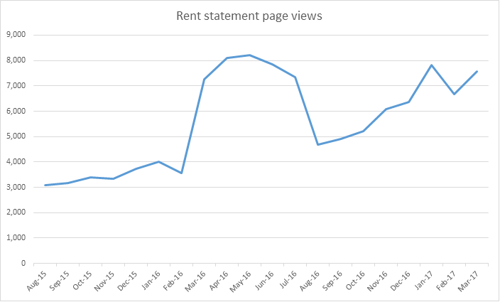
3
Welfare Reform
Self-Service

Slide 11
3
Performance
Outcomes
CIH Winners 2017 – Best outcomes for residents
HQN Income Accreditation
Year on Year reduction on evictions bucking the nationwide trend
Decrease on applications for court – saving 55k in last 2 years

Slide 12
3
Thanks for listening
Any Questions?

