Slide 1
Housing Affordability and Younger People in the South East of England: Capping Aspiration?
Professor Ian Cole
Professor of Housing Studies Centre for Regional Economic and Social Research Sheffield Hallam University

Slide 2
Questions for today
why was an extension of the Help to Buy scheme announced by Philip Hammond on Sunday?
why did Theresa May announce, eventually, £2bn additional investment in affordable housing on Wednesday?
why is there going to be a Green paper taking a positive view towards the future of social housing?
why was a positive rent settlement for social landlords from 2020 announced yesterday?
not too difficult to find the answers

Slide 4
Vote Share: 18 to 24 year olds

Slide 5
Vote Share: 25 to 34 year olds

Slide 6
Vote Share: 65 years old and over

Slide 7
The new divide
age now as important a determinant of voting behaviour than social class, income or ethnicity
and the clock is ticking...
generation rent decided to vote this time, after Brexit result
financial crisis of 2007/8 especially affects those without assets with little income uplift in past ten years
and baby boomers have been cosseted

Slide 8
The lucky ones

Slide 9
The unlucky ones

Slide 10
An intergenerational comparison
Issue | Me | Bryony
Chance of being a home owner | 62% | 36%
Average age of first time buyer | 30 | 34
Average age for having first child | 25 | 29
How long it takes to save for a deposit on average | 3 years | 19 years
Proportion of income spent on housing on average | 10% | 18%

Slide 11
Regional stretch in house prices
 | 1980 | 2016
Ratio of Greater London house prices to Yorkshire and Humberside prices | 1.75 | 3.19
Ratio of Rest of South East house prices to Y and H house prices | 1.68 | 2.06

Slide 12
Capping Aspiration - approach to analysis
assessment of secondary data sources in South East
qualitative assessment of younger people's housing needs
assessment of housing association responses to the challenges facing younger people

Slide 13
Context - high and rising private sector housing costs
House prices have increased by more than twice the national average, and private sector rents have risen more than in any other region (including London) since 2016.
Median rents are £850pcm in the SE compared with £650pcm nationally
PRS, typically the 'ready access' sector, is unaffordable for many: 51% of 16-34 year olds cannot afford lower quartile private sector rents; 76% cannot afford rents at the 50th percentile.

Slide 14
Context - incomes not keeping pace with rising housing costs
Disposable household income in the South East increased by just 1% from 2013 to 2014 - lower than UK average - despite strong economic growth
23% of younger households (ie. headed by a 16-35 yr old) are claiming HB or UC
higher unemployment rate for younger people (7% compared with 4% of other age groups)

Slide 15
Does social housing sector still cater for lower income households?
Survey of Flagship Housing Group tenants (n=2628):
The majority (57%) have a gross h/h income of less than £15,600 pa
Survey of social housing tenants in the VRtB pilot areas (n=668) and application form data (c300)
42% have gross h/h income of less than £26k
30% have no savings
Baseline survey of 1,600 social housing tenants in the DPDP areas for DWP (2015)
Only 10% of tenants had any savings
55% had 'very often' or 'fairly often' run out of money in the past 12 months

Slide 16
Social tenants: living on the edge
Significant proportion of social housing tenants report 'just about' or 'not quite' managing (e.g. 50% of Flagship tenants)¹
32% of tenants were assessed as 'at risk' of unaffordable rent in 2016 and 6% had unaffordable rent
This combined total of 38% increases to 49% with the introduction of direct payment
The estimated financial loss to h/hs in GB arising from post 2015 welfare reforms is £12.3bn per year to 2021²
nearly half of these losses fall on working age households in the social rented sector²
1. See also survey results reported in https://www.gov.uk/government/uploads/system/uploads/attachment_data/file/388561/rr889-direct-payment-demonstration-projects-longitudinal-survey-of-tenants.pdf; and http://shura.shu.ac.uk/14923/1/CRESR_VRTB_pilot_research_-_main_report.pdf_dm_i%3D3R33%2C53DS%2C11XSI5%2CH05V%2C1 in addition to Flagship research results
2. Analysis conducted by CRESR for Crisis (unpublished)

Slide 17
Can social rented sector take the strain in housing low income younger people?
younger people represent 20% of social housing tenants in the South East
HAs accommodate 60% of younger people on HB in the region
introduction of LHA rates into social housing brings with it the shared accommodation rate (SAR)
which represents a key challenge, given the limited (almost non-existent) supply of shared housing in the sector

Slide 18
Impact of the SAR
once the SAR is introduced, social housing rents in the South East will become unaffordable for most younger people
84% of existing single tenants would have a shortfall if the SAR were applied to their current claim.
the average weekly shortfall between HB and social rent across the South East would be £55. This would leave a job seeker in the 16–24 age group with £2.79 a week to cover all living costs.
the average weekly shortfall rises to as much as £77.60 in some areas

Slide 19
Challenges
the (convenient) presumption in favour of sharing in welfare policy is not matched by available stock in the social rented sector (SRS)
existing models of shared housing and low cost self-contained products in the SRS cannot be let at the SAR and be financially viable
HA properties and management arrangements reflect long-standing housing priorities. Will they be able to adapt and prioritise the disparate ‘under 35s’ group?
little appetite in the sector for developing shared housing, but some initiatives have been introduced
but little appetite for shared housing among younger people, too
'my own space...that's what I want out of life, a place of my own to call home, not my mum's house or my cousin's house'

Slide 20
Younger People's Housing Aspirations
Housing association preferable to the PRS
costs
better management
better standards
tenancy security
Strong desire for self-contained accommodation
regardless of space standards...
...but location still important
Reticence about sharing:
More pronounced for some groups than others
More positive feedback for 'managed' models of sharing
Strong ownership aspirations for some groups
Absence of decent housing advice and support
and often poor experiences when approaching LA for help

Slide 21
Younger People's Housing Aspirations
so what can be done?

Slide 22
Meeting younger people's housing needs - some broad approaches and options
remodel existing stock (from 1 bed flats to tower blocks) to provide shared accommodation
new development/purchasing of shared accommodation
develop low cost self-contained accommodation
use partnerships (e.g. support agencies; private landlords)
self-contained vs shared
self financing vs (cross) subsidised
new development vs remodel
general needs vs extra support

Slide 23
Specific models / schemes
Low-cost self-contained housing,
Y:Cube scheme (YMCA) in Merton
Richardson Yard container housing (Brighton Housing Trust) in Brighton
Shared houses and flats
Snugbug (St Vincents) in Manchester
Enfield Single Housing (Origin Housing)
A midlands ALMO's shared accommodation pilot
Larger shared housing schemes
Lea Bridge House (Paradigm Housing Group) in Leyton
Partnerships
South Yorkshire Housing Association and a 'Help to Rent' scheme (Nomad Opening Doors)

Slide 24
Y:Cube

Slide 25
Y:Cube interior

Slide 26
Y:Cube
relatively low cost. £30k exc. land (scheme=£2.3m for 37 units)
5½ months 'build' time
will pay for itself after 14 years at current rent levels
28 sq metres (below minimum LA space standards)
no exceptional maintenance and management costs
tenants on AST (can't be permanent)
very popular with tenants/applicants
compares favourably to containers?
Some important details
rents are £148pw inc. service charge (SAR is £82.46 and 1 bed LHA rate £167.24) - but could be let for less?
targeted at tenants who are working or in education leading to work with no/low support needs. Marketed as 'aspirational housing'

Slide 27
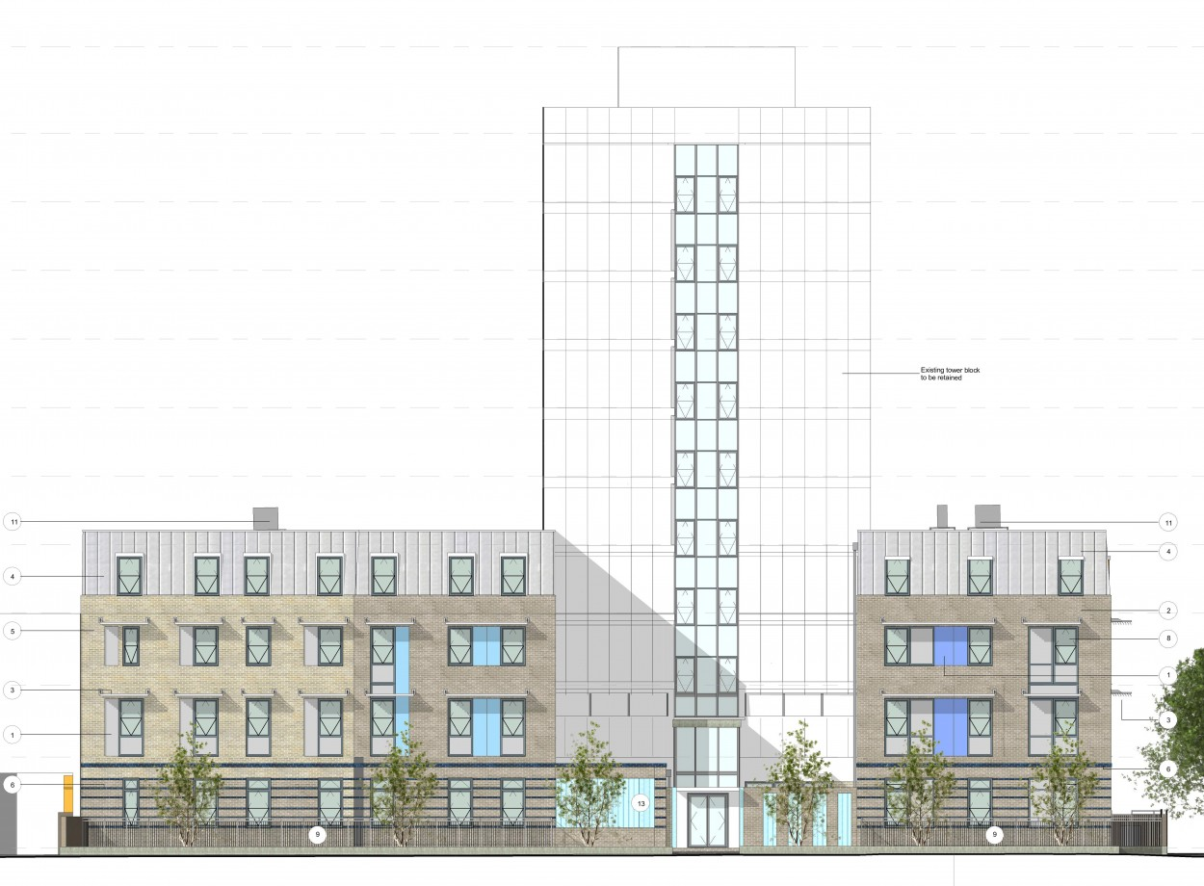
Lea Bridge House

Slide 28
Lea Bridge House - shared housing at scale
tower block +annexes; 229 'bed spaces'; around 14 tenants per floor, some share kitchen and bathroom, 106 rooms have small en-suite shower and toilet
for (non-stat) single homeless people over 25 referred by agencies working with homeless people
very high demand
did use ASTs but tenants now on licenses
dedicated housing management team, staff presence on site
no specific HM problems (more problems in smaller shared houses)
no additional measures in place (lead tenants, training etc)
financially viable
Some important details
rents are within the 1 bed LHA rate but nearly double the SAR
financially viable because of the scale
do not accept tenants thought to pose a problem for others

Slide 29
Shared houses and flats
Snug Bug (Manchester)
60 4-bed shared houses (their own and leased from other HAs)
weekly visits from SnugBug coordinator and a 24 hour 'ranger' support service
pre tenancy training
rent set within the SAR
Enfield Single Housing
305 units with 2 or 5 sharers (inc. 1 bed properties); some dispersed but many concentrated on one estate
rents over the SAR (average c. £113, SAR is c. £91)
tenants on licenses
2 shares reported to work better from a HM perspective, but 5 shares better financially
tenant matching, and advice and support offered

Slide 30
Partnerships
South Yorkshire Housing Association and Nomad Opening Doors
SYHA makes properties available to a local 'Help to Rent' scheme
Nomad uses the properties to accommodate under 35s in 'non-priority' need
SYHA provide landlord services, Nomad provides intensive tenancy support (includes 'matching' tenants)
shared housing - 2 or 3 sharers
mainly non-standard properties, some leased from the PRS
classed as exempted properties, and so tenants received enhanced HB

Slide 31
Conclusion
fault lines in housing market are increasingly marked by age than by tenure or locality
for under 35s, not just affordability but type and quality of accommodation
specialist provision for younger people so far - a mix of opportunism, experimentation and improvisation
less evidence of a strategic approach to meet their needs, akin to an older person's strategy
think in terms of a spectrum of support and provision, both shared and self-contained as the cohort contains immense socio-demographic and financial diversity
explore options for partnership with local authorities and others over assets (eg land)

Slide 32
Conclusion
'The development of an evidence-based, intelligent and flexible strategy to meet the housing needs of those under 35 will not in itself mitigate the deepening crisis that many.. will face in the next few years: but it may help to stimulate the introduction and development of many more innovatory and creative schemes, whether as one-off experiments or integrated within mainstream budgets, partnerships and development programmes' (Capping Aspiration: p38)
Otherwise there will be continued intergenerational conflicts..
Rather than intergenerational harmony, like this.....

Slide 34
The report
Capping Aspiration - the Millennial Housing Challenge (2017). Ian Cole, Stephen Green, Ben Pattison, Kesia Reeve, Ian Wilson, Tom Archer
CRESR Report for CASE/Sovereign HA
http://www4.shu.ac.uk/research/cresr/sites/shu.ac.uk/files/capping-aspirations-the-millennial-housing-challenge.pdf

