Slide 1
16-25 ACCOMMODATION PROGRAMME
UPDATE
Robin Cahill

Slide 2
16-25 Commissioning Intentions
 | Phase 1 - COMPLETED |  | Phase 2 |  |  | Phase 3
 | Supported Accommodation in a Family Environment SAiFE (formerly Supported Lodgings) |  | Supported Accommodation in a Non Family Environment (inc. Floating Support) Replacement of ‘spot’ purchasing and alignment of HRS to prioritise statutory service users |  |  | Shared Accommodation (self-supporting) predominately UASC
 | New service in place June 2016 |  | Planned Autumn 2016 REVISED - New services in place for 2018/19 |  |  | Planned 2017 REVISED New Services in place for 2018/19

Slide 3
Background & History
Thirteen Suppliers have delivered Young People at Risk & Teenage Parent Accommodation and Floating Support Services (Supporting People) since 1st April 2012 (1st April 2013 for the two Floating Support contracts).
The contracts were extended for a further year from 1st April 2015 to the 31st March 2016.
During this period the Supporting People Service, as part of the Transformation Programme, went through a reorganisation. As such future procurement was placed on hold awaiting a decision on the new priorities for the Service.
Supporting People Housing-related services for young people were transferred to Specialist Children Services in May 2015. The future commissioning of housing-related support services are now part of the 16-25 Accommodation and Support Commissioning Plan.
The total number 16-25 year olds accessing the 24 services since 2012 is:

Slide 4
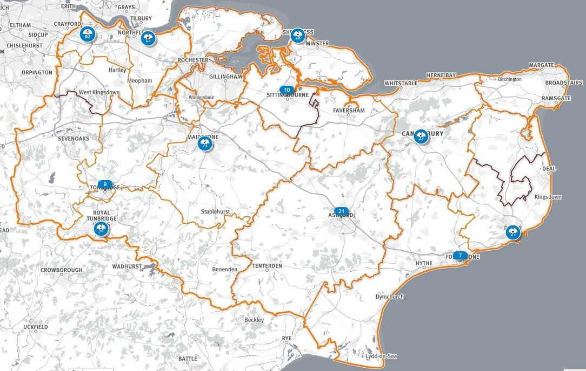
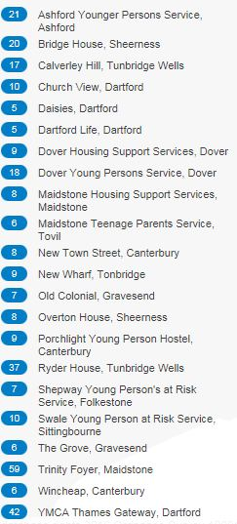
HRS Current Service – Location and Capacity
Belgic Court (Ashford) – due to launch Jan 17 – 8 units ( 4 identified for CLs)
In addition:
Floating Support (countywide) – 138 units

Slide 5
Position to Date
Delayed Procurement due to:
HRS efficiency requirements and lack of confirmed budget
HRS savings delivery now delayed until 2018/19
Member directive to develop synergies with Adults commissioning
An additional year granted by the Leader in order to develop:
All age homelessness strategy (YP Sufficiency Strategy)
Manage transition to new statutory-focussed service model
New service proposed to begin April 2018
Current service redesign (interim year):
Focus on data & evidence gathering
Transition current providers to refocus on statutory service users
Engagement with District & Borough Councils
Pilot Belgic Court / Set-up Referral Panels / referral process

