Slide 1
Troubled Families in Kent Update for Kent Housing Group
Katherine Atkinson
Head of Information & Intelligence
Strategic Lead for Troubled Families

Slide 2
Service Transformation
Service transformation since April 2015 – focus on continuous improvement
New Unit model for intensive support
Early Help brought staff from multiple directorates into a new division
Operational work structured in twelve districts across four areas
Troubled Families embedded within the Early Help Units – an integrated approach to family support

Slide 3
EHPS Strategy and Three Year Plan
Four Principles
We involve children, young people and families,
Four Work Strands
Ensure a whole system partnership approach across the range of Early Help and Preventative services in Kent
Decisions are informed by professional judgement and the working relationship with the child and family
Work is outcome focused, informed by evidence, performance and evaluation
We strive to improve life chances build family resilience and use the strengths of families
Develop effective family focused practice approaches
Support good health and emotional well-being
Promote educational and vocational achievement

Slide 4
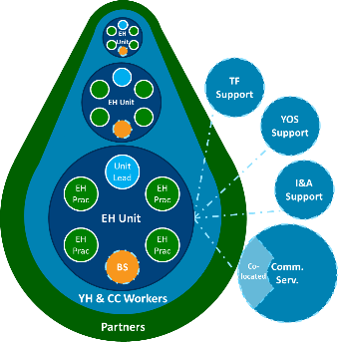
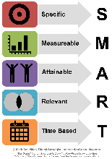
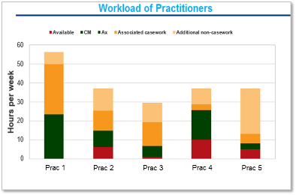
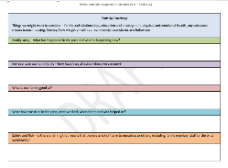
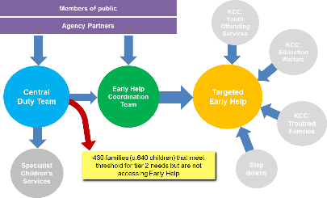
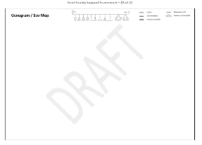
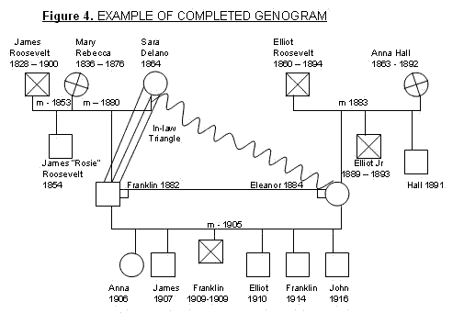
EHPS Delivery Model
Unit Structure
Dashboards and Trackers - Outcome Focus
Open Access
Step Down Panel
EH Service Model
Management Support & EH Toolkit
Workload, not Caseload
Unit Meetings
Kent Family Support Framework
Triage
Signs of Safety

Slide 5
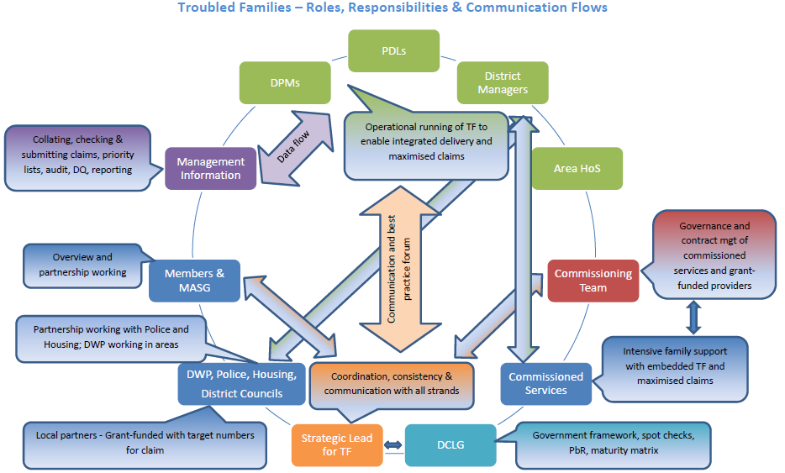

Slide 6
Troubled Families Claims
 | 2015/16 | 2016/17 | 2016/17 | 2016/17 | 2016/17 | 2016/17 | 2016/17 | 2016/17 | 2016/17
 | 2015/16 | Claims submitted to Audit MAR 17 | Claims submitted to DCLG JAN 17 | Claims submitted to DCLG SUMMER 16 | Potential Total 2016/17 | Indicative Percentage towards STRETCH TARGET | Stretch target | Indicative Percentage towards MINIMUM TARGET (DCLG) | Minimum target (DCLG)
ASHFORD | 0 | 73 | 90 | 58 | 221 | 144.4% | 153 | 184.9% | 120
CANTERBURY | 1 | 51 | 74 | 63 | 188 | 83.2% | 226 | 106.5% | 177
DARTFORD | 2 | 33 | 49 | 34 | 116 | 154.7% | 75 | 197.9% | 59
DOVER | 0 | 83 | 87 | 63 | 233 | 110.4% | 211 | 141.3% | 165
GRAVESHAM | 2 | 52 | 79 | 64 | 195 | 137.3% | 142 | 175.7% | 111
MAIDSTONE | 1 | 62 | 91 | 40 | 193 | 129.5% | 149 | 165.8% | 116
SEVENOAKS | 0 | 27 | 35 | 36 | 98 | 122.5% | 80 | 156.8% | 63
SHEPWAY | 0 | 72 | 85 | 57 | 214 | 120.2% | 178 | 153.9% | 139
SWALE | 7 | 60 | 128 | 78 | 266 | 91.1% | 292 | 116.6% | 228
THANET | 1 | 106 | 102 | 59 | 267 | 92.7% | 288 | 118.6% | 225
TONBRIDGE & MALLING | 3 | 48 | 92 | 40 | 180 | 130.4% | 138 | 166.9% | 108
TUNBRIDGE WELLS | 3 | 36 | 34 | 28 | 98 | 108.9% | 90 | 139.4% | 70
GRAND TOTAL | 20 | 703 | 946 | 620 | 2269 | 112.2% | 2022 | 143.6% | 1580

Slide 7
Partnership Working
Family assessments and plans include partnership working focus wherever appropriate
Good links with Health, DWP, Police and Housing
Recent spot check by the DCLG assessed our work across a range of randomly selected cases and involved interviewing two Early Help workers…one of these told a strong story about the success of working with Housing to turn around a range of issues for a family

Slide 8
DCLG Maturity Model
Early Help maturity model that all Local Authorities are required to complete to assess their development against six key strands:
The family experience of transformed services; Leadership; Strategy; Culture; Workforce Development; Delivery Structures & Processes
Current completing initial assessment but want to share draft with key partners to seek input and ensure it is thorough and honest
A process that will be updated annually and subject to peer review

Slide 9
Areas for Development
Further embedding of Troubled Families outcomes into Early Help intensive work, to maximise claims and align practice even more fully
Youth Justice and Open Access – opportunities
Specialist Children’s Services – opportunities
Partnership working and communication – district links critical
Building on areas identified in the maturity model once completed for this year

