Slide 1
Kent Housing Group
Kent Housing Group
17th May 2017

Slide 2





  Our vision – Adult Social Care
“Your Life Your Wellbeing”
  Where people live
Accommodation Strategy
Promoting
Wellbeing
Centred around the
Individual
“a life not a service”
Promoting
Independence
Supporting
Independence
  Through transition on an all age pathway
Age 16 to 18
End
of life
  Supported by building blocks
Safeguarding
Workforce
Commissioning
Integration\ Partnerships

Slide 3
The Vision for Adults
Promoting Wellbeing
Promoting Independence
Supporting Independence
Services which aim to prevent, delay or avoid people from entering formal social-care or health systems, by helping people to manage their own health and wellbeing.
Providing short-term support that aims to prevent or delay people’s entry to the formal care system, and provide the best long term outcome for people. They will have greater choice and control to lead healthier lives.
Delivered through services for people who need ongoing support and aims to maintain wellbeing and self-sufficiency. The aim is to keep people safe and help them to live in their own homes, stay connected to their communities and avoid unnecessary stays in hospitals or care homes.

Slide 4

People want a LIFE not a SERVICE
What we asked people:
What does a good life look like for you and your family and how can we work together to achieve it?
ORDER OF PRIORITY

Slide 5

Kent County Council Budget
Notes:
Reprofiling budgets
Extraordinary budget meeting
Representing budget due to and extraordinary Change

Slide 6
Housing Related Support
Learning Disability
Mental Health
Older People and Physical Disability
Domestic abuse
Homelessness
Other commissioning news
Mel Anthony

Slide 7
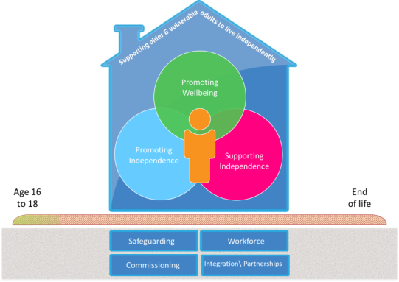
  Housing Related Support – Social Care Priorities and direction
Support for children in care and care leavers in line with the council’s corporate parenting duties
Prevent the need for care home admissions and/or support discharge from other institutes hospital, prisons etc.
Prevent pressure on other budgets e.g. homelessness in vulnerable people and domestic abuse
Synergies between most housing related support services and the commissioning intentions in Adult Social Care
Opportunities to better align the housing related support with the mainstream delivery and reduce duplication both within KCC and its key partners
Opportunities to reshape and reconfigure provision to support the council’s transformation ambitions and save money in the longer term
Echoes themes of the 2014 CIH needs analysis

Slide 8

  OP/PD - Opportunities to Deliver Differently
OUTCOME BASED CARE
Accommodation Strategy sets out a clear vision for an extra care future
Opportunities to reduce duplication in both funding and provision
Explore opportunities within Outcome Based Care
HRS 19m | LD 3.3m | MH 2.8m | OP/PD 3.9m | YP 3.7m | Home lessness 4.7m | Dom Abuse 1.7m | Sub Misuse 195k | Offenders 742k
SIS 35m | LD 30m | MH 2.5m | OP/PD 2m

Slide 9
  Learning Disability - Opportunities to Deliver Differently
Combine both SIS and HRS into Your Life Your Home Project
Create capacity in the market to achieve the aims, objectives and targets of YLYH
Include Children with Disabilities to improve the transition pathway for transition
Create efficiencies in streamlining financial oversight
Complement the Kent Pathways Service and include Independent Living Scheme (ILS)
HRS 19m | LD 3.3m | MH 2.8m | OP/PD 3.9m | YP 3.7m | Home lessness 4.7m | Dom Abuse 1.7m | Sub Misuse 195k | Offenders 742k
SIS 35m | LD 30m | MH 2.5m | OP/PD 2m
YOUR LIFE, YOUR HOME

Slide 10
  Mental Health - Opportunities to Deliver Differently
LIVE WELL KENT
Explore opportunities within Live Well Kent Strategic Partnership to include new services as part of offer – what about accommodation?
Opportunity to include Dual Diagnosis? i.e. substance misuse/learning disability
HRS 19m | LD 3.3m | MH 2.8m | OP/PD 3.9m | YP 3.7m | Home lessness 4.7m | Dom Abuse 1.7m | Sub Misuse 195k | Offenders 742k
SIS 35m | LD 30m | MH 2.5m | OP/PD 2m

Slide 11
  Offender - Opportunities to Deliver Differently
Explore opportunities CRC/Probation
CRCs have new responsibilities and are bedding in
They are already commissioning housing related support services such as floating support
It’s sensible to explore opportunities for these services to be included in new and existing commissioning strategies
Platform for clear information sharing
Streamline pathways
HRS 19m | LD 3.3m | MH 2.8m | OP/PD 3.9m | YP 3.7m | H’lssnesss 4.7m | Dom Abuse 1.7m | Offenders 742k
SIS 35m | LD 35m | MH 2.5m | OP/PD 2m

Slide 12
  Domestic Abuse - Opportunities to Deliver Differently
Co-designed new Commissioning Strategy
With the support of a multi-agency task and finish group a new an integrated domestic abuse service
Collaboration of KCC, Office of PCC, KFRS, District CSPs
Live from 1 April 2017
Referral pathway information can be found at www.domesticabuseservices.org.uk/professionals
Next step is commissioning of a Training Education and Awareness provider
HRS 19m | LD 3.3m | MH 2.8m | OP/PD 3.9m | YP 3.7m | H’lssnss 4.7m | Dom Abuse 1.7m | Offenders 742k
SIS 35m | LD 35m | MH 2.5m | OP/PD 2m

Slide 13
  Homelessness in Vulnerable People - Opportunities to Deliver Differently
No identified duplication within KCC
Opportunity to pool resources other commissioners of complementary services outside the authority
Rationalise, redesign and commission a flexible, coherent service based on shared outcomes rather than funding arrangements
Integrated supported accommodation and outreach services
Clear pathways focus on prevention
More effective solution for “frequent fliers”
HRS 19m | LD 3.3m | MH 2.8m | OP/PD 3.9m | YP 3.7m | H’lssnss 4.7m | Dom Abuse 1.7m | Offenders 742k
SIS 35m | LD 35m | MH 2.5m | OP/PD 2m
Co-design new Commissioning Strategy

Slide 14
  Homelessness – better together
Important to understand the co-dependencies and relationships between us
CLG Social Impact Bond for Entrenched Rough Sleepers in East Kent and other CLG grants
Changing costs in one area is likely to cause additional unintentional costs in another other
Better to consider together
Mindful of the changes that the Homelessness Reduction Bill will bring and future funding arrangements for supported housing.
We can’t do this alone and don’t want to – we need your help

Slide 15
Live Well Kent
Community Services for Mental Wellbeing
Jo Empson

Slide 16
Integrated Commissioning
Public Health; universal services that support prevention, emotional health and wellbeing
Adult Social Care; day opportunities, employment services and service user engagement
Clinical Commissioning Groups; acute, secondary and community mental health services and improving access to psychological therapies
Supporting People; housing related support and specialist housing schemes
Historically services worked in silos focussing on particular issues or steps in a journey
We developed a new integrated and outcome focussed approach that is design to enable people to lead the lives they want
Aim to tackling stigma and improving well-being

Slide 17
Key facts ….
Total pot 4m per year
Historic funding re-profiled and allocated according to need
A 5yr contract with an optional 2yr extension clause
Contract let in four lots to mirror CCG cluster areas
Outcomes focused contract with some specified requirements around employment and housing
Includes co-location of primary care social workers

Slide 18
Kent County Council
Contract Management
Local Groups and Community Assets
Strategic Partner
Partnering Agreement
Partnering Agreement
Delivery Partner
Grant
Delivery Partner
Delivery Partner
Contract
Delivery Partner

Slide 19


What we have achieved …the model
  A new sustainable model to support wellbeing, self management, promote recovery, tackle social isolation, build resilience, and reduce stigma
  Built on foundation of peer support, connectivity and community development – a life not a service
  Focus on prevention and early intervention to reduce need for secondary mental health services and use all services more effectively – reducing duplication
  Proportionate performance management with a focus on outcomes and impact

Slide 20




Slide 21




Live Well Kent Delivery Model

Slide 22
Performance Year 1
In the period from the 1st April 2016 – 31st December 2016
Over 4,000 referrals with 3,157 people formally signed up for a service or intervention
1,142 people have declared that they have a serious mental health diagnosis
1,710 have declared they have a common mental health diagnosis
305 have not declared a diagnosis
Highest numbers coming from self – referrals route
Statutory referrals also high
GP referrals are lower, however, both Strategic Partners are working with GP to increase referrals from this route
GP are also recognised as signposting clients to the service who then show as self referral. Working to develop the feedback loop with GPs to evidence impact.

Slide 23
Successes
Long term contract enables relationships /services to fully develop and embed
Innovation fund - non traditional growth in offer
Sense of purpose/direction for the growing network
Shift to recovery focus enabling improved wellbeing for people who had been “stuck”
Manage concerns - working together to sort issues
Better visibility of performance and impact
Closer monitoring of services enabling continual improvement
Ability to mix up the delivery network when requirements change or providers are not performing
Increase in peer support across services
Embedding of co-production in delivery model

Slide 24
Challenges
Lack of baseline data vs. sheers numbers referred !
The institutionalisation – people and providers
Cultural change from "care in the community" services to personalised and progressive services
Targeting different populations within the spectrum
Working to develop complimentary not duplicatory support
Ironing out issues in pathway .. SPs have different models working towards consistent offer
Balancing co-production and partnership with the caveats of procurement and legal
Need to get the right pay mechs to reflect the ethos of co-production and service
Learning to balance partnership with performance management - importance of both formal and informal sessions

Slide 25
Next Steps
Market Shaping Contract Clause …
  “Additional elements may be added to the delivery of this contract during the lifetime of this contract. This would be agreed by both parties and may carry a different contract term. This may include such elements as Supporting Independence Services and/or Mental Health Supported Accommodation either directly provided or through other payment methods.
  (This would not exceed the overall financial threshold or possible contract term of seven years).”

Slide 26
Budget and Financial Information
Total budget as of March 2016
Different hourly rates for these services
Contract | Value
HRS | 2.8m
SIS | 2.5m
Total | 5.3m
Contract Type | Average Hourly Rate
SIS | £13.97 (£14.22)
SIS Plus | £15.88 (£16.16)
HRS | £15.95
The proposal is to increase SIS rates by 1.76% from 01 April 2017.
These new rates are shown in brackets

Slide 27
 | Housing | Support
Legislative/Policy | Changes to housing benefits – under 35’s Need to better model housing needs | Better predicting support needs through Strategic Partners
Joined Up Vision/Strategy | Have an Accommodation Strategy in place that supports developers to understand need, but… Informing strategy to support discharge needs - accommodation | Need to look at how Strategic Partners inform/are aware of strategy/new builds Informing strategies to support discharge needs - support
Supply and Demand | Need for more realistic and affordable housing options i.e. - Emergency Housing - Single occupancy flats - Move on / Step down How do we better link with / manage relationships with private landlords Exploring reasoning behind joint landlord/service provision schemes – rationale and risks How to promote and manage change to Individuals who have been promised a home for life (Assured tenancies) How can we support improved supply i.e. Bring derelict properties back into use | Joining up the start of Accommodation with support package, supported by Strategic Partner No info on new build projects or KCC housing strategy Understanding individual needs when modelling demand i.e. Adults in a shared environment could set them back on recovery journey Why do people have to move on-support could vary rather than person changing home

Slide 28
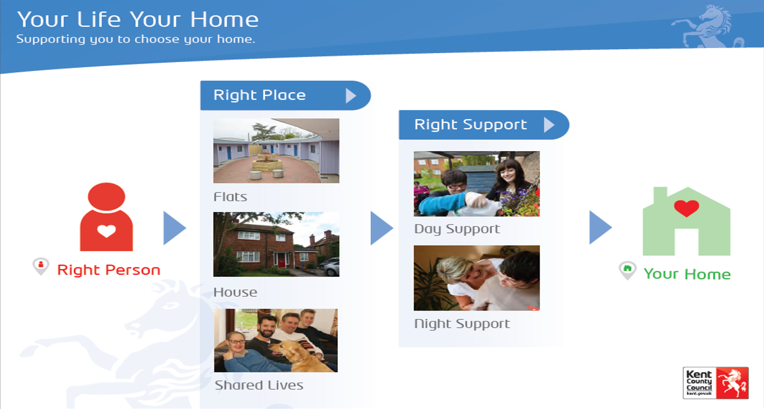
Your Life, Your Home Mental Health
What’s the plan?
Project to take 1 year
Our aim is to move around 100 people with Mental Health needs from residential care to new housing
Transfers will be done slowly to minimise disruption and make sure the right housing is available
The project is currently being implemented for people with a learning Disability, to date 106 people with a Learning Disability have moved into new housing
Notes:
What are we doing?
Reviewing the opportunity for a number of people with a mental health need that currently live in residential care, to live in alternative settings that will allow them to lead more independent lives. There are just under 300 people with a MH in residential care.
Why are we doing it?
We believe that ‘people with mental health needs are entitled to the same aspirations and life changes as other people’.

Slide 29
Older People and People Living with Dementia Core Offer
Commissioning Plan
Sam Sheppard

Slide 30
Designing a Core Offer
The core offer is part of a preventative pathway that will (alongside newly designed triage processes and a digital offer) promote wellbeing and reduce demand by:
developing a range of community based wellbeing services that will prevent or delay entry into formal health and social care systems by promoting individual wellbeing,
providing an easily accessible resource that both health and social care triage points can refer to,
referring people on into community based resources.

Slide 31
Current Position
  At the moment, we have a good range of services and support with lots of innovation and best practice, provided via a wide range of voluntary/community sector partners but:
  it is not consistently networked together,
  there is a post code lottery and inequity of access due to historic funding,
  no consistent approach to measuring outcomes and impact,
  funded through short term, annual grants.
Notes:
Will this be different from the past? What will that mean for users?

Slide 32
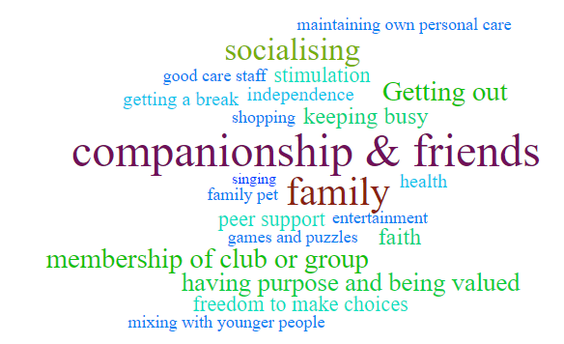
What people tell us is ‘most important’

Slide 33
A Core Offer Contract
To address these issues, the core offer contract will:
be outcomes based
include a newly designed ‘care navigation’ type role
focus on community hubs
have a ‘no wrong door’ approach
apply learning from Live Well Kent contract
We expect the contract value of the contract to be equivalent to the value of the historic annual grants which fall within scope of this project
  £4,328,215 per year for older people
  £803,244 per year for people living with dementia

Slide 34
Opportunities
  We would like to understand:
  How this links with the work that is being undertaken on a housing core offer?
  How housing and social care navigation / IAG resources work together and whether this means joint commissioning or a coordinated pathway?
  Where services such as handyman services fit within the models?
Notes:
Will this be different from the past? What will that mean for users?

Slide 35
Next Steps*
Task | Date
Ongoing Market Engagement (now until) | 07/06/17
Public Consultation (6 weeks starting) | 09/06/17
Cabinet Committee | 20/07/17
Tender begins | August 17
Contracts Awarded (KSP) | Dec 2017
Contracts Awarded (Delivery Network) | Jan 2017

