Slide 1
Self Build & Custom Build Event Ashford, Kent Planning Policy Update
20 October 2016
Alastair Pollock – Strategy Coordinator, South Essex Housing Group

Slide 2
Summary
Geography
National Policy
What’s happening in South Essex?
Learning from the past – Plotlands, Basildon
Looking to the future – Graven Hill, N Oxfordshire
Issues going forward

Slide 3
South Essex sub region

Slide 4
National Planning Policy Framework
The NPPF – in expecting authorities to have a clear understanding of housing needs in their area – states that need should be addressed for all types of housing, including people wishing to build their own homes. This is also recognised in the PPG, which states that local authorities should plan to meet the strong demand for such housing

Slide 5
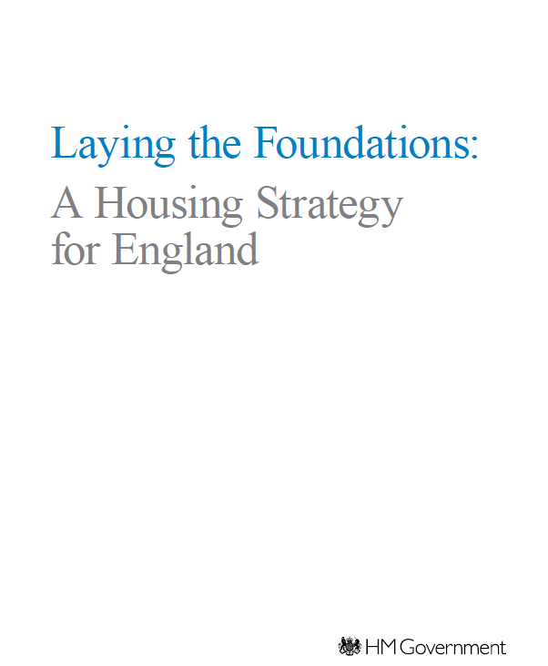
Laying the Foundations: a Housing Strategy for England
The strategy states that, in 2011, over 100,000 UK residents were looking for building plots across the country, with around one in ten new homes custom built
This is considerably lower than in many other European countries, and recent figures suggest that – while there is demand – there are relatively few self-build homes in the UK, with just 8,235 delivered in 2013 – a fall of 22% since 2010
However, as many as half of people
nationally would consider building
their own home if they were able to do so

Slide 6
Self-Build and Custom Housebuilding Act 2015
Legislative framework for the first part of Right to Build
From 1 April 2016, this requires local authorities to establish local registers of custom builders wishing to acquire suitable land to build their own home, and local authorities should have regard to demand from this local register when exercising planning functions
This will provide a valuable future mechanism for monitoring demand for self-build and custom build housing across South Essex, which should be used in the development of Local Plans

Slide 7
What’s happening in South Essex
Questions asked
Is your local register fully set up?
If so, how many people do you have on your register?
What does your local plan saying about custom / self build?
What plans does your authority have for allocating sites for custom / self build now or in the future?
How are you promoting Self Build / Custom Build in your authority?

Slide 8
Summary of Responses
LA | Register set up | Numbers accepted | Planning Policy | Promotion on web site
Basildon | √ | 3 | √ But only site specific | Yes
Castle Point | √ | 0 | × | Yes
Rochford | √ | 36 | × | Yes
Southend | √ | 8 | × | Yes
Thurrock | √ | 3 | × | Yes

Slide 9
Thurrock
Local register administered by Site3 on behalf of Housing Team
Thurrock’s adopted Core Strategy (as amended) does not specifically mention custom or self-build. The emerging Local Plan will look at options for promoting self-build and specific questions have already been asked in the Issues and Options stage
Thurrock will be exploring the suitability of sites to be allocated for this purpose as part of our 2016 HLAA and will be inviting the National Custom and Self Build Association to participate on the HLAA stakeholder panel
The initiative is promoted on their website:
https://www.thurrock.gov.uk/forms/register-interest-in-building-your-own-home and https://www.thurrock.gov.uk/finding-somewhere-to-live/self-build-and-custom-housebuilding

Slide 10
Recent Survey Thurrock cont.
43% of existing households (2,870 implied households) and
30% of concealed households (1,146 implied households)
planning a move within the borough would be interested in planning and constructing their own home
The majority of these households would be interested in refurbishing an empty property and bringing it back into use as housing
Only a comparatively small proportion of households had the funds immediately available to purchase a plot of land, however, suggesting that finance could restrict households from meeting their needs through this option
38% households no savings, 89% had less than £20,000

Slide 11
Basildon
Three accepted applications (underwent a basic citizen check to become accepted). Of which one has expressed an interest anywhere in the Borough whilst the other two have stipulated sites in either Wickford or Billericay. See: http://www.basildon.gov.uk/selfbuild
Basildon new Draft Local Plan – reference to Custom / Self Build only in relation to housing sites, see Plotlands (history covered later)
Beachwood Village / Craylands regeneration, Swan currently marketing 200 units for custom build with plans for self build in future phases. See: https://www.nuliving.co.uk/nu-homes/custom-build
Designations in the future might typically include corner sites on or within council estates which may not be popular with the applicants

Slide 12
Rochford
Local register fully set up
36 on register as at 20/9/16 (a number of applications have been refused due to insufficient information)
Custom / self build policy in the new Local plan?
Site allocations in the new Local plan?
Promotion done through rolling banner on RDC homepage

Slide 13
Southend
Register set up 1 April (http://www.southend.gov.uk/info/200232/housing/564/strategic_housing/2).
8 applicants on our register
Reference in the new Local Plan if the evidence supports it – it will form part of the preparation
No firm plans to allocate sites as yet but it will form part of their considerations when undertaking future feasibility assessments of Council owned land
Register is available on website and Strategic Housing web-pages
Links to the National Custom & Self Build Association’s Self Build Portal

Slide 14
Castle Point
Register set up, but no response to-date
However, a number of people are doing it already without going via the register. Eg buying sites on Canvey Island often bungalow and building two story housing

Slide 15
Plotlands – Origins
Origins in decline of agriculture 1850s
Farms collapsed & building / land sold
http://www.essexrecordofficeblog.co.uk/tag/plotlands/

Slide 16
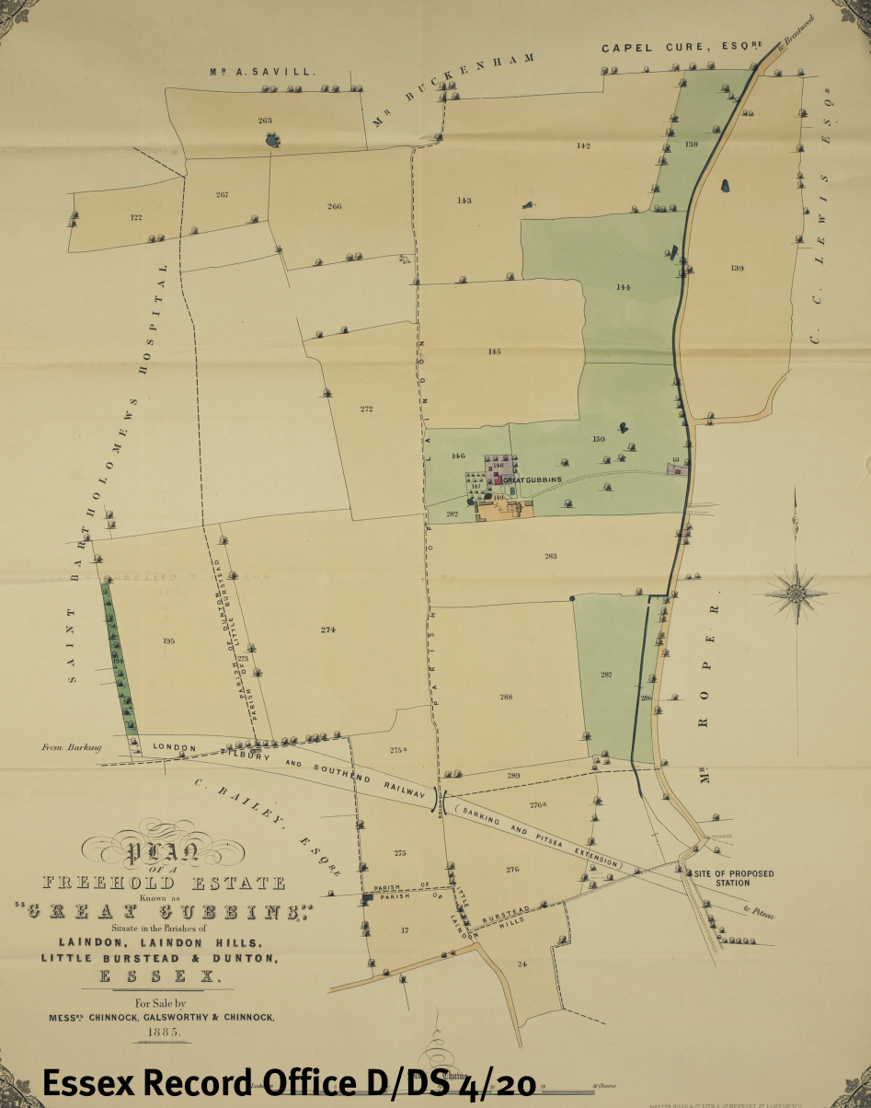
Plotlands – Development
Coming of the railway boosted sales
Land parcelled up 20x140ft plots (hence plotlands)

Slide 17
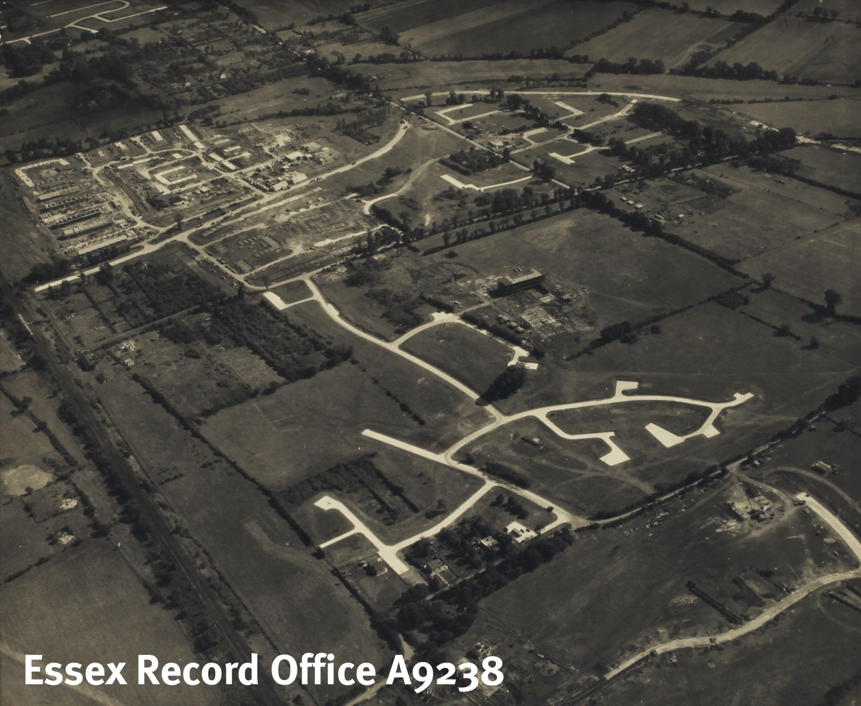
Plotlands – The Passing
Development of chalets then bungalows
1962 Development Corporation buy up plots
1970 Basildon New Town created
Plotlands extinguished

Slide 18
Case Study: Graven Hill North Oxfordshire
Graven Hill an ex airport trailblazing site for self / custom build, largest in England
new homes programme (10 years)
Currently occupied by the MoD , vacating over next five years
188 hectares south of Bicester (=300 football fields)
Led by Graven Hill Village Development Company, delivery 10 year programme
Outline planning for 1,900 new homes, along with a primary school, employment space, a local pub/restaurant and a small number of local shops
Over £2.5 million of work began on site in early 2016
Includes the demolition of disused Ministry of Defence buildings and construction of the first access roads
The first Golden Brick plots in Phase 1A was released for sale from 22 August 2016
Further plots released gradually in batches over the coming months and years
http://gravenhill.co.uk/

Slide 19
Issues / discussion
Lessons learnt from the passing of the Plotlands?
Difficulty for planners to undertake the role of matching people to land. Not a normal planning function. Struggling to do this...
31 October regulation will be difficult to meet
Some potential applicants are matching with their own land
Might work well on big scale / site, but for one off sites harder to deliver
There is also the matter of planning consent
Issue for Green Belt land too

Slide 20
Thank you!
Alastair Pollock
South Essex Housing Strategy Coordinator
apollock@castlepoint.gov.uk

