Slide 1
A Presentation to
Housing Strategy and Enabling Sub Group
of the
Kent Housing Group
26th January 2016

Slide 2
Landspeed is an Affordable Housing Provider (AHP)
Primary Activity
To acquire & deliver Section 106 Intermediate Affordable Housing to qualifying purchasers
To deliver shared ownership and affordable shared equity (shared purchase) products
To manage and assist homeowners, with initial purchase, home management, future sales & staircasing
Secondary Activity
To provide supporting affordable housing values to housebuilders/developers
To advise local authorities/housebuilders/developers on size standards, unit mix & integration
To advise local authorities/housebuilders/developers on Section 106 Deeds
To troubleshoot for local authorities/housebuilders/developers
Landspeed’s ethos is simply to ensure Section 106 affordable housing is maximised and delivered in every instance

Slide 3
Issues Confronting Delivery of Affordable Housing
* Viability
* Grant and Subsidy
* Lack of consistency from RP’s
* Delivery of small Section 106 affordable allocations
* Achieving preferred Tenure Mix
* Housing & Planning Bill and proposed changes to NPPF

Slide 4
Housing & Planning Bill and proposed changes to NPPF
* Starter Homes
* ‘Help to Buy’ Shared Ownership
* Right to Buy
* Rent Reductions
* Duty to consider selling vacant high value housing
* Payments to Secretary of State by local housing authorities (from vacant sales and rent increases)
* Reducing 'social housing' regulation
What will be the potential impact caused by the uncertainty of changes and possible future role of RP’s and HCA and how can this be minimised?

Slide 5
Considerations that may assist to minimise impact to Section 106 affordable housing delivery
Encourage deliverable tenure mixes for small Section 106 affordable allocations:
* Expand definitions and operative clauses to offset potential delivery difficulties
* Allow for possible variations to tenure and/or unit type if no RP interest
Apply practical integration and unit sizes for Section 106 affordable housing
* Allow standard developer house/apartment types
* Consider higher proportion of studio and 1 bedroom apartments
Do not capitulate to Section 106 viability arguments
Minimise acceptance of commuted payments in lieu of Section 106 affordable units
Restrict proliferation of Section 106 DMS and other affordable products not currently NPPF compliant
Restrict use of Preferred Provider status within Section 106 deeds:
* Allow for inclusion of Affordable Housing Provider in addition to standard RP definition
Consider introduction of Local Household Income Thresholds:
* Controls affordable sales pricing
* Creates potential ability to target specific income groups &
* Alleviates pressure on rented sector by lifting lower income households into ownership

Slide 6
Example of Comparative Tenure Affordability
Example 1 - Discounted Market Sale ( 80%)
Single Household - 30 year repayment mortgage (Saffron BS*) *Extremely limited mortgage availability
Unit Type | Size | OMV £ per sq ft | OMV Unit Price | Help to Buy Shared Equity Unit Sale Price £ | % of OMV | Stamp Duty £ | Deposit @ % | Deposit @ £ | IMR @ 4.49% | Monthly Mortgage Repayment | Rent on Balance @ % | Rent on Balance £ pcm | Service Charge pcm | Total Housing Cost pcm | Minimum Income Required
2 Bed apartment | 790 | £253 | £200,000 | £160,000 | 80% | £1,500 | 10.00% | £20,000 | £140,000 | £715 | 0% | £0 | £80 | £795 | £32,404
Example 2 - Traditional Shared Ownership
Single Household - 30 year repayment mortgage (Nationwide)
Unit Type | Size | OMV £ per sq ft | OMV Unit Price | Shared Ownership Unit Sale Price £ | % of OMV | Stamp Duty £ | Deposit @ % | Deposit @ £ | IMR @ 3.89% | Monthly Mortgage Repayment | Rent on Balance @ % | Rent on Balance £ pcm | Service Charge pcm | Total Housing Cost pcm | Minimum Income Required
2 Bed apartment | 790 | £253 | £200,000 | £66,000 | 33% | £0 | 20% | £13,200 | £52,800 | £251 | 2.75% | £307 | £80 | £638 | £26,008
Example 3 - Affordable Shared Equity
Single Household - 30 year repayment mortgage (Nationwide)
Unit Type | Size | OMV £ per sq ft | OMV Unit Price | Affordable Shared Equity Unit Sale Price £ | % of OMV | Stamp Duty £ | Deposit @ % | Deposit @ £ | IMR @ 1.89% | Monthly Mortgage Repayment | Rent on Balance @ % | Rent on Balance £ pcm | Service Charge pcm | Total Housing Cost pcm | Minimum Income Required
2 Bed apartment | 790 | £253 | £200,000 | £150,000 | 75% | £1,500 | 5% | £10,000 | £140,000 | £513 | 0% | £0 | £80 | £593 | £24,171

Slide 7
Examples of Landspeed Affordable Schemes

Slide 8
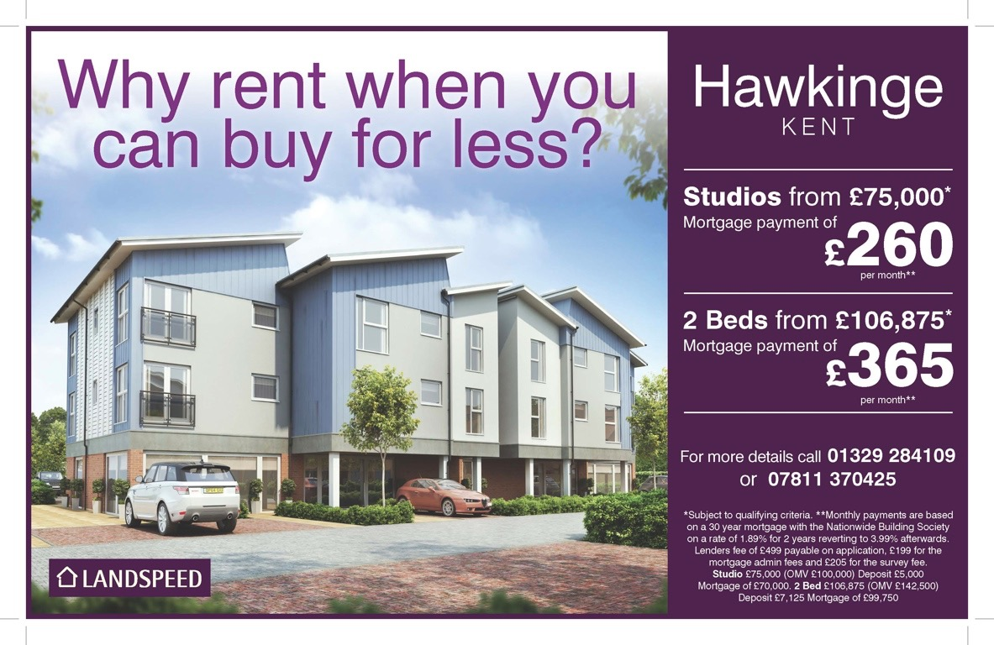
Examples of Landspeed Affordable Schemes

Slide 9
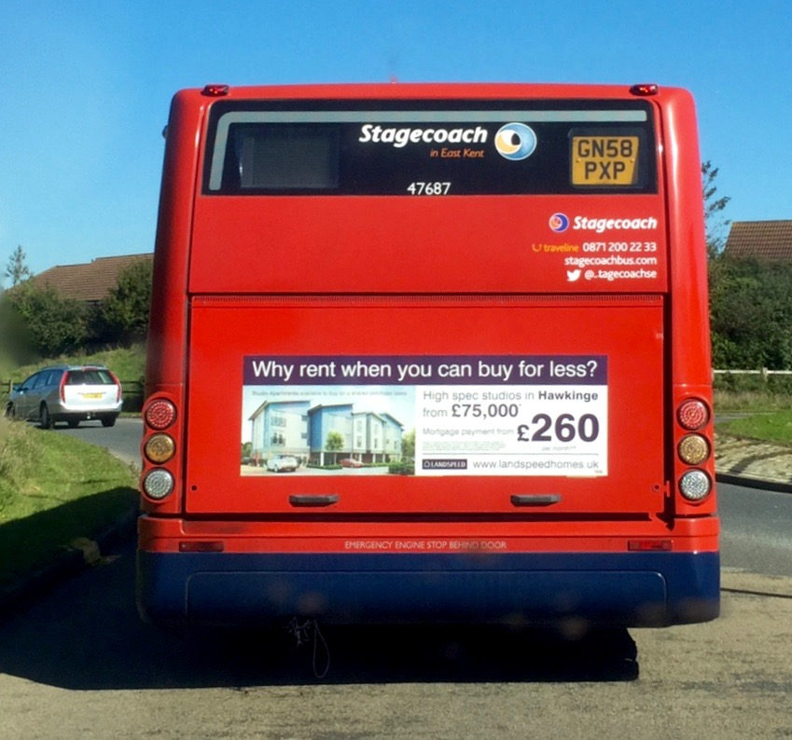
‘…looks like the back end of a bus…’

