Slide 1
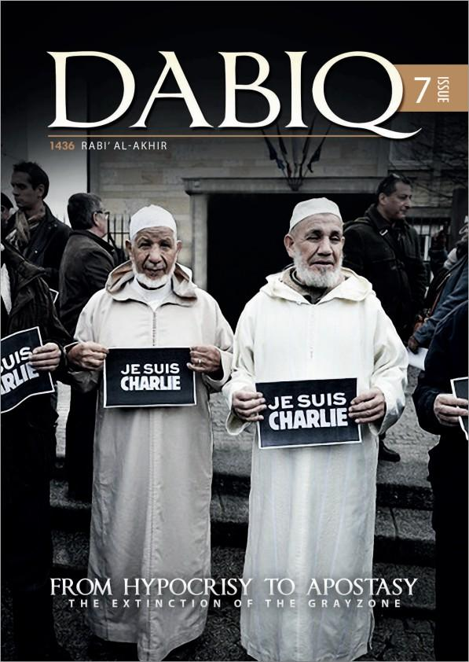
Books & Publications
Dabiq is the title of an extremist periodical published online by the Islamic State (IS/ISIS/ISIL/Daesh).
Dabiq is a sophisticated, slick,
professionally produced propaganda and radicalising tool, aimed at recruiting foreign fighters and justifying the violent actions of Islamic State.
Dadiq boasts of Islamic States’ victories and portrays a romantic image of a glorious new caliphate based on holy war.
It features explicit images of dead and mutilated “infidels” and photoshopped images of famous sites in the West under Islamic State control.
Always brief a supervisor or Prevent contact at the earliest opportunity.
Notes:
1

