Slide 1
Maintaining Delivery and Services
Kent Housing Group Seminar
20th April 2016
Alistair Smyth
Head of Policy
National Housing Federation

Slide 2
What I’ll cover today
The political and policy landscape
Some key issues
Supply
Home ownership
Voluntary Right to Buy
Supported housing and LHA
The rent cut
Owning our future
What we need for success

Slide 3
The housing election
Housing was a top 5 issue at the election
Government has made its commitment to housing clear
Our task: to ensure that this is translated into policy that allows the sector to deliver

Slide 4
New housing and welfare policy
Rapid pace of change, driven by the politics
Commitment from the top to resolve the housing crisis
The Government’s focus:
Supply and ownership
Shrink Welfare Benefit bill
Housing associations –
“The orange that hasn’t been squeezed yet”

Slide 5
In under one year…
VRTB
Rent Cut
Devolution
Home Ownership
Supply
All change
Reclassification
Deregulation
LHA Cap

Slide 6
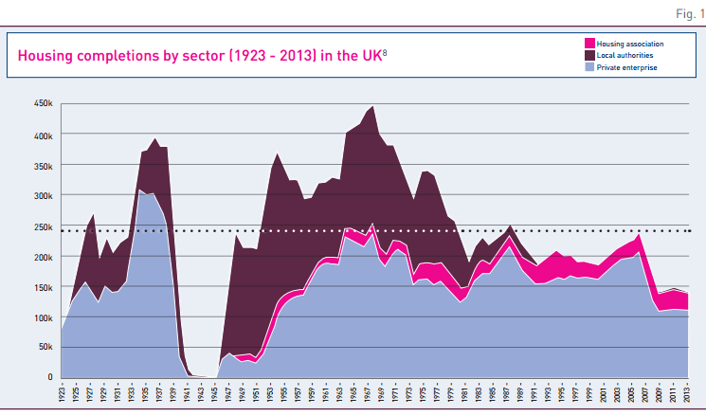
CSR: “For we are the builders”

Slide 7
“A crisis of home ownership”

Slide 8
The government expects…
Starts by 2021:

Slide 9
A sector ambition to deliver
Where we are:
50,000 homes in 2014/15
Where we want to be:
120,000 homes by 2033

Slide 10
Voluntary right to buy
4 key principles:
Every HA tenant would have the right to buy a home
Board discretion over which homes to sell
Full compensation for the discount
Flexible 1-4-1 replacement

Slide 11
Supported housing
We are:
Co-creating a new funding model for supported housing
Continuing to push for clarity around the LHA cap
A lot at stake:
£68 per week per affected tenant
41% of existing schemes could close
80% of new developments may not happen

Slide 12
The rent cut

Slide 13
We need to own our future
We’re launching a new strategy, Owning our Future, to bring housing associations together to collectively reposition our sector. That means doing three things:
telling a compelling shared story
building the relationships we need
delivering on the substance.

Slide 14
Owning our Future: key points
The housing association sector currently does not have any instinctive political allies
There is a sense that the sector is bad at defining itself – but other people are filling the gaps and defining the sector for themselves
All groups see increasing housing supply as the prime function of housing associations
Conservatives place greater emphasis on housing associations focusing on home ownership – but not necessarily to the detriment of other tenure
Those who interacted with housing associations tended to appreciate the sector’s contribution more
There is a perception of poor performance in the sector – even despite positive personal experiences
Every interviewee saw the sector continuing to play a role in meeting housing need in the UK.

Slide 15
What we need now:
Rent freedom

Slide 16
Alistair Smyth
National Housing Federation
020 7067 1046
alistair.smyth@housing.org.uk
@alistair_smyth

